Slide 1

Environmental Security: 2050
Concepts and Strategic Connections
Mad Scientist 2016, Washington DC
Elizabeth L. Chalecki, PhD
University of Nebraska – Omaha
Stimson Center

Slide 2
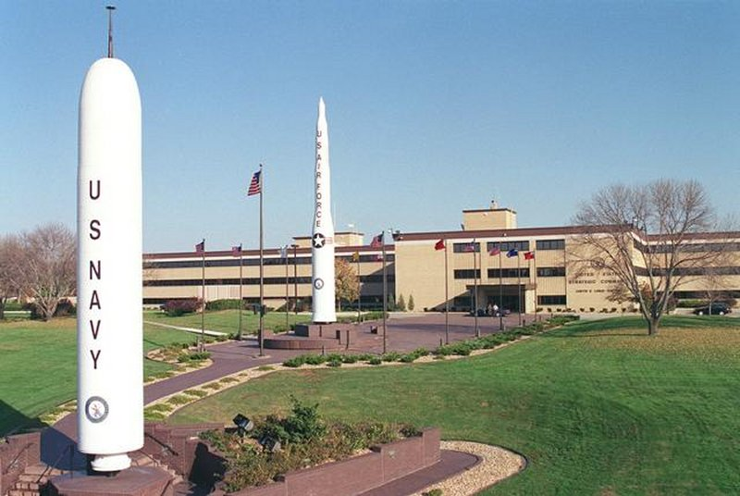
Conventional Views of National Security
National security resulted from military victory on the battlefield
Realist security is a zero-sum game
  Sovereign nations are inviolable
  Morality is irrelevant
Collective security is problematic
  Different nations have different security values
  High probability for defection
Security traditionally considered “high politics”
“Low politics” issues, including environment, relegated to lesser priority
US STRATCOM

Slide 3




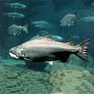

Ecosystem Services
Disease regulation
Dispersal of seeds
Mitigation of floods & droughts
Pest control
Nutrient cycling
Maintenance of biodiversity
TOTAL: approx. $125 trillion (Costanza et al 2011)
Climate stabilization
Moderation of weather extremes
Pollination of plants
Protection against uv radiation
Detoxification and decomposition of waste
Soil generation
Air & water purification
Notes:
Estimated $33 trillion per year (1997; GWP comparison $18 trillion), updated to $125 trillion (2011; GWP comparison ~$63 trillion)

Slide 4
Environmental Security and
Natural Resources
Are resources always beneficial to security?
How can they be managed?

Slide 5
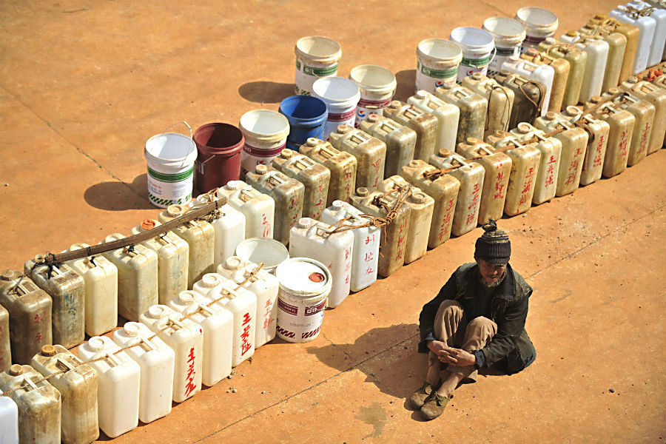
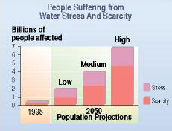


Water Security
Source: IFPRI/Veolia 2011
Water wars? Not yet…
Notes:
Water is an input into every other process: agriculture, energy, industry, health, development – all requires fresh water
Mark Twain (?) – ‘whisky is for sipping, water is for fighting over’ → water wars?
263 international river basins (Wolf et al, OR State Basins at Risk project) – water too important to fight over
How to ensure water security? Privatization? +\-. Exported or Bottled water? +/-.

Slide 6
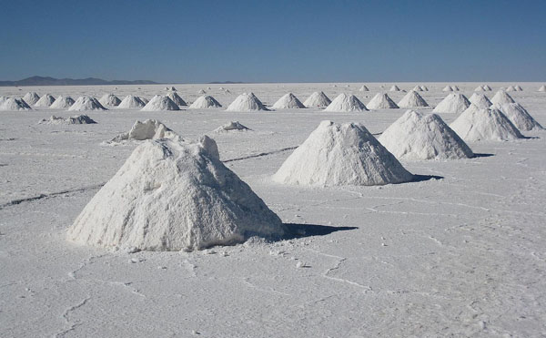
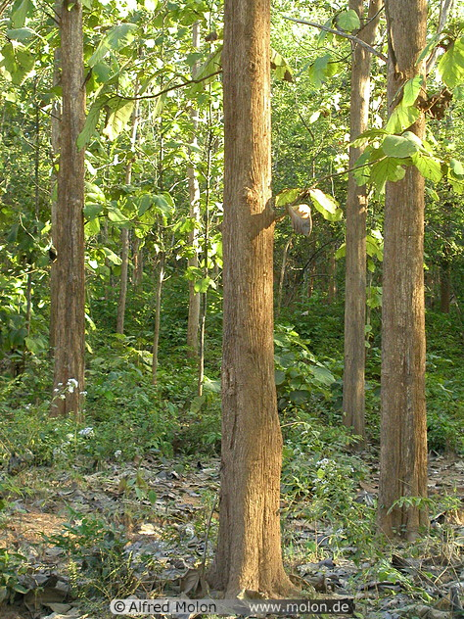
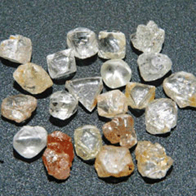
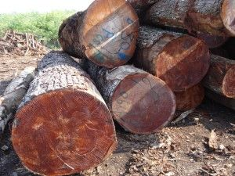
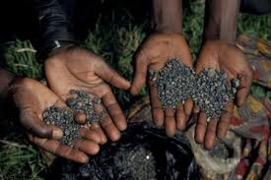
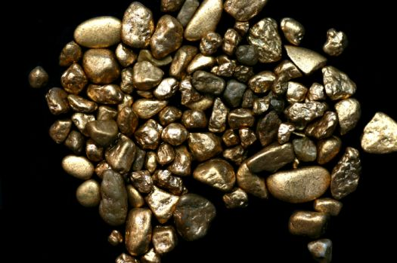

“Lootable” Resources
Resources fuel conflict:
Angola
Dem. Rep. of the Congo
Peru
Colombia
Indonesia
Dutch Disease: economic mal-development as a result of resource abundance
Notes:
Resource abundance fuels conflict by allowing combatant groups to loot resources in exchange for cash, weapons
Governments who rely on rents for revenue (so-called rentier states) tend to become corrupt
Even well-run countries are vulnerable to Dutch Disease, weakening their manufacturing base

Slide 7
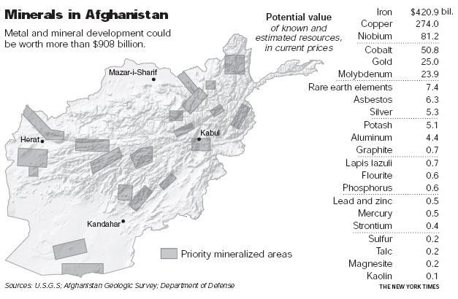
Resource Curse
Resources alone do not cause conflict
If the state has a transparently functioning government in place, resource wealth can be managed
If resource wealth arrives before democracy and transparency, state adopts rentier behavior
Notes:
What determines whether a country falls prey to the Resource Curse? If govt then wealth, likely not; if wealth, then govt, likely so (kleptocracy)
Bolivia, with its lithium wealth, is attempting to avoid this
What can or should be done re: mineral wealth in Afghanistan? Should western companies be involved?

Slide 8
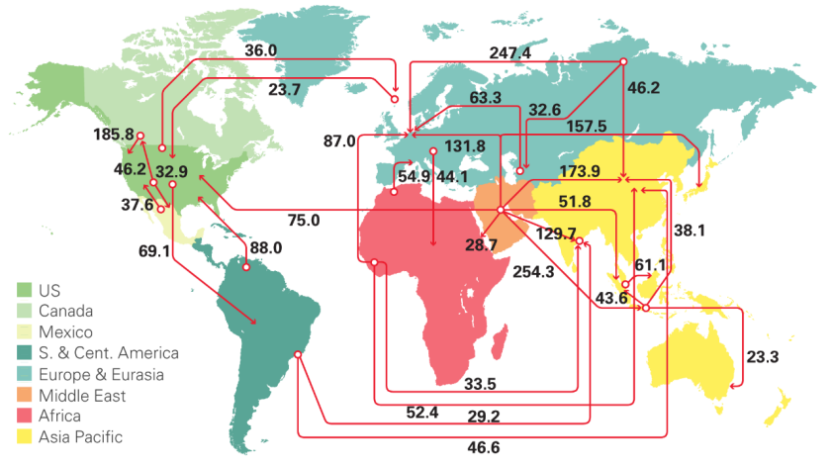
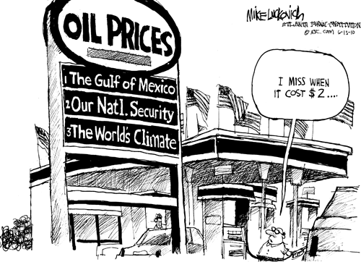
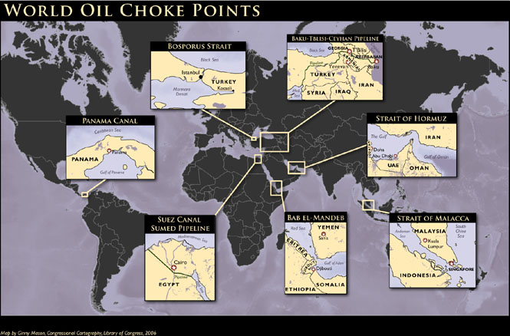
Petroleum
Petro-States (Karl 1997)
Both importers and exporters are dependent
Infrastructure vulnerable to sabotage
Energy security imperiled at choke points
Source: BP Energy Outlook 2016
Source: Library of Congress
Notes:
Petroleum is unique b/c it presents security concerns for both oil exporting and importing nations:
Oil not as lootable as other resources b/c it requires permanent infrastructure – tends to fuel Petro-states governments rather than rebel factions; sabotage always a concern
Importing nations see energy independence as the goal – realistic?
If choke points get blocked, energy security imperiled;

Slide 9
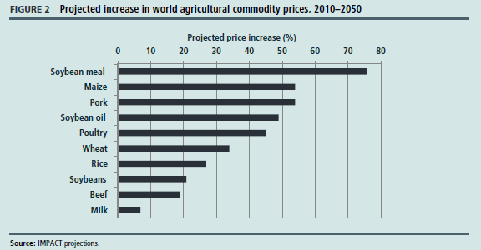
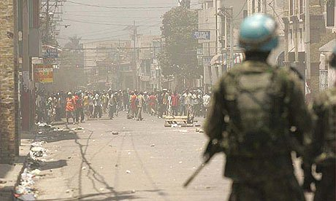
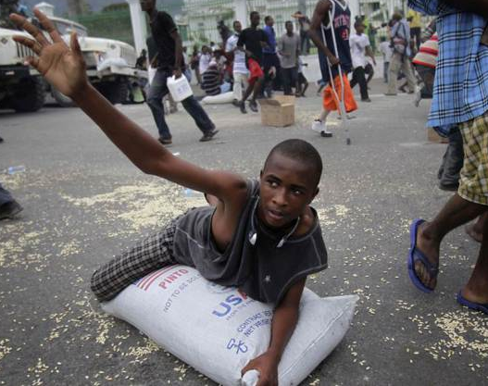
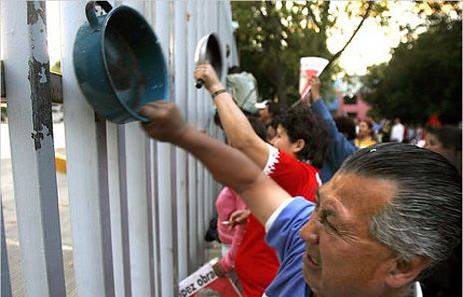
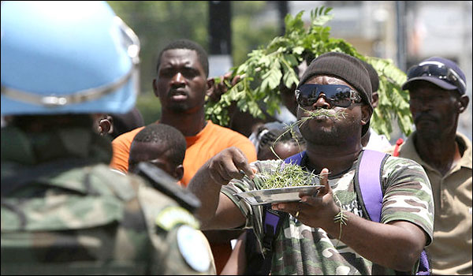
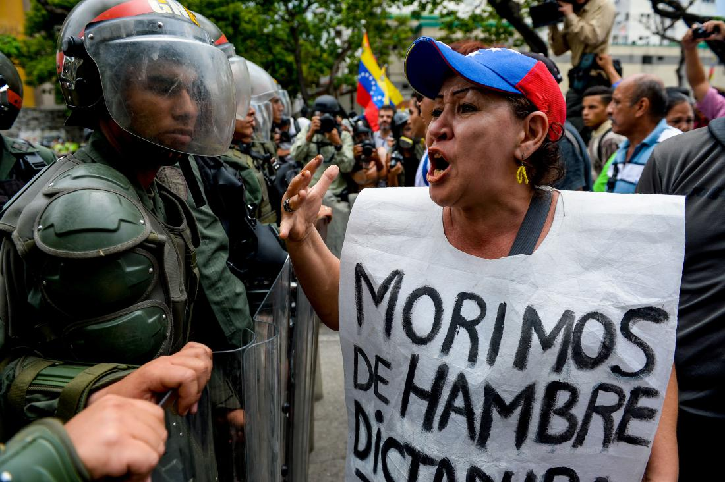
Food Insecurity
4 pillars of food security:
Availability Utilization
Access Stability
Source: IFPRI 2012
Factors that affect food production:
Climate change
Development of biofuels
Soil erosion
Factors that affect food distribution:
Increasing global wealth
Global markets
Food loss/waste
“Faminogenic” behavior
Notes:
By 2050, est. 9.4 billion people in the world, food production will have to increase btw 60%-100% from 2015 levels
Food riots: Egypt, Mexico, Haiti, Congo, Mozambique → Arab Spring → Venezuela now
Food as a weapon: governments can engage in faminogenic behavior for political purposes

Slide 10
Environmental Security and
Climate Change
How can we account for climate change
as a threat multiplier?
What inputs do we need for conflict models?

Slide 11
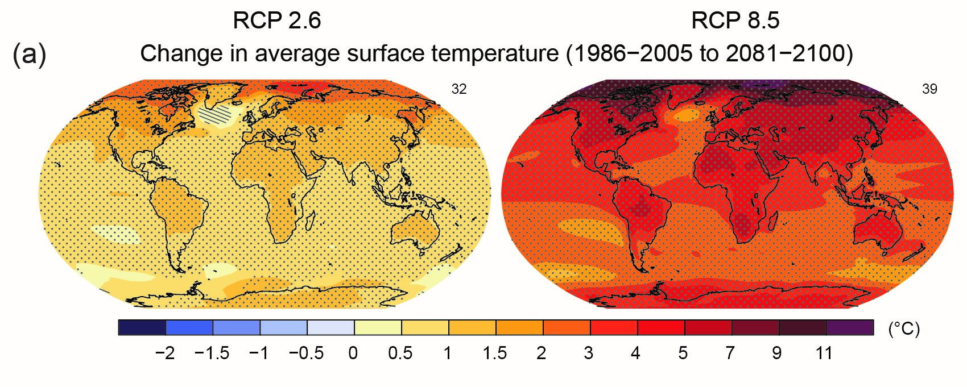
IPCC AR5 on ambient air temperature…

Slide 12
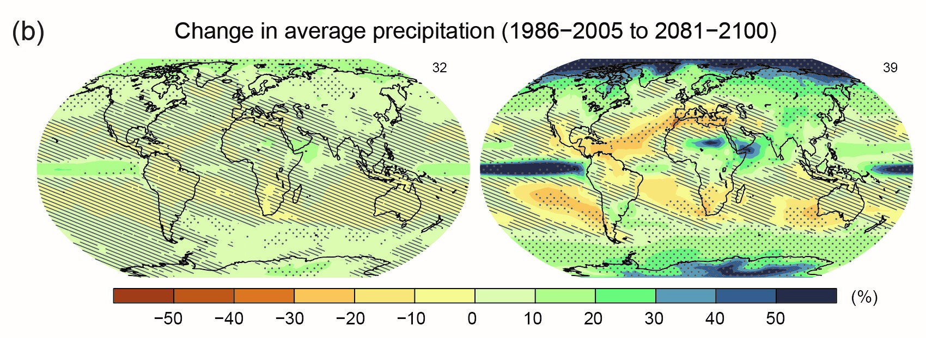
IPCC AR5 on time and form of precipitation…

Slide 13
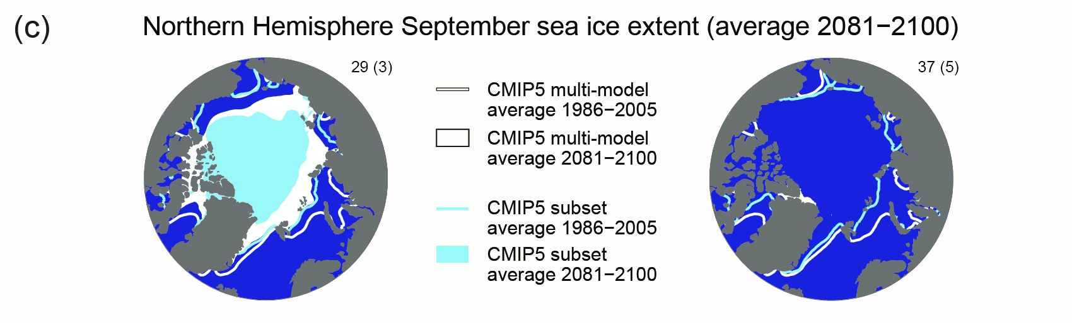
IPCC AR5 on an ice-free Arctic…

Slide 14
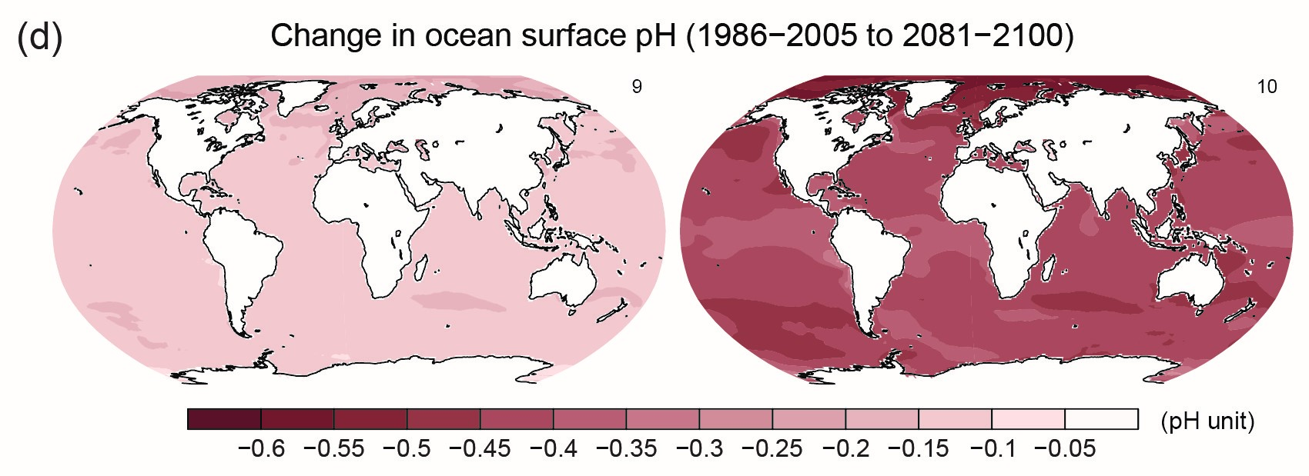
IPCC AR5 on ocean acidification…

Slide 15
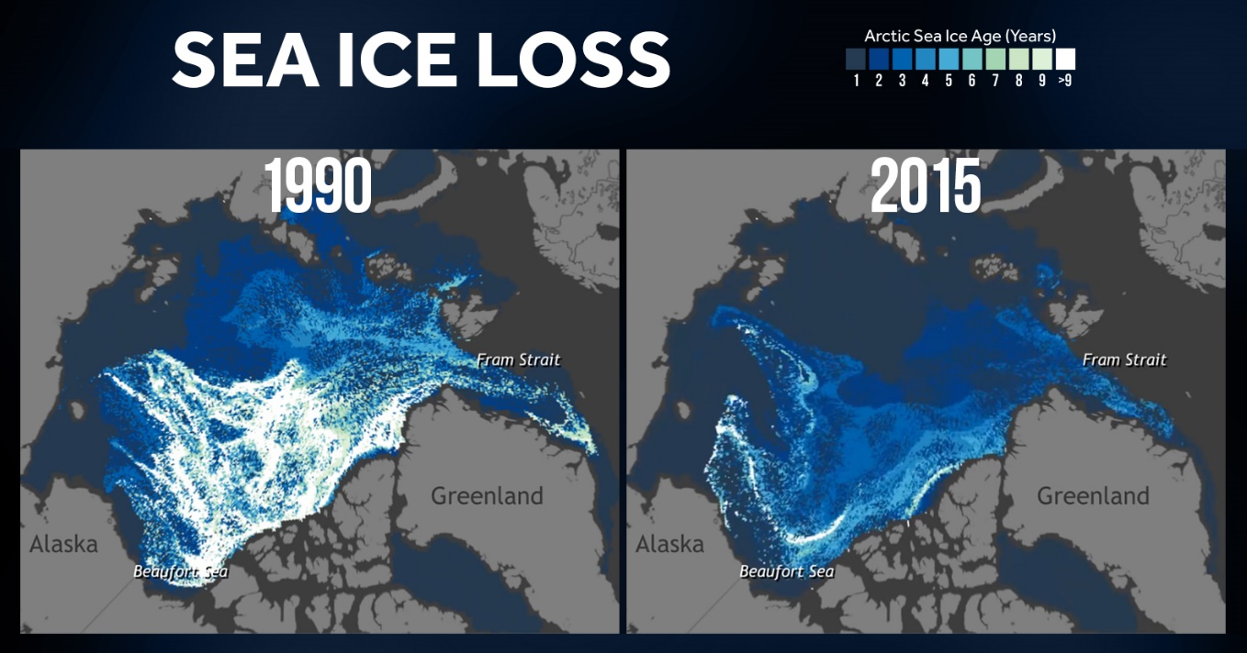
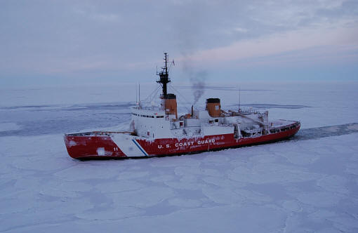
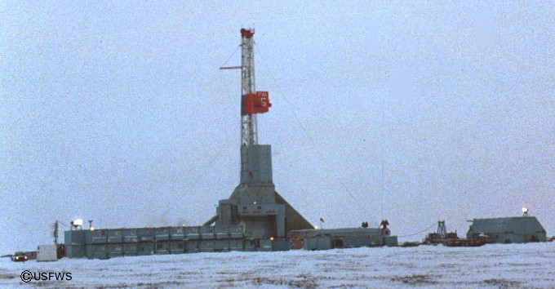
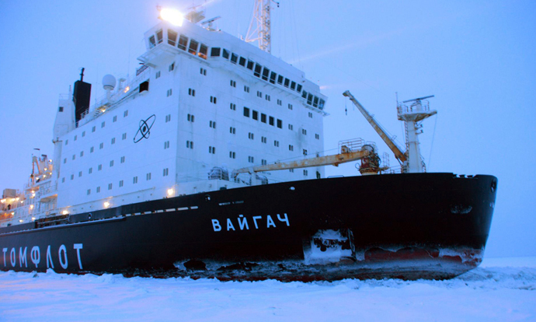
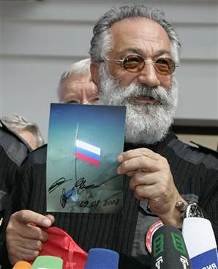
Arctic Resources, Operability
Russia far in the lead, Canada/Nordics following
United States nowhere to be found
Wild West? or New Regime?
Source: NSIDC
Resources include petroleum, strategic minerals, cold water aquaculture
Transit across the Northern Sea Route
Notes:
Arctic warming faster than the rest of the globe
USGS (2008) btw 18% and 22% of world’s petroleum reserve lies north of the Arctic Circle (Positive feedback loop!); also strategic minerals

Slide 16
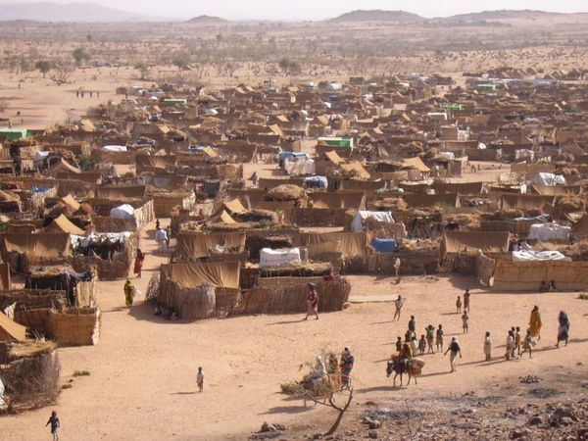
Migration
Climate change affects push factors more than pull factors
What is a refugee?
UN: “a person who is outside their country of origin … because they have suffered (or fear) persecution on account of race, religion, nationality, social group, or political opinion”
Protected by non-refoulement
Refugees can threaten border security, food supplies, and cultural homogeneity – contain or assimilate?
Notes:
Definition of “refugee” expanded in custom to include those fleeing war, violence, or torture, and IDPs in concept; notice what is NOT there
Refugees protected by the concept of non-refoulement: they cannot be expelled back into conditions in which their lives are threatened; cc not one of those conditions
Sea level rise, extreme events (floods, storms/hurricanes, droughts, heat waves)
Contain or assimilate?

Slide 17
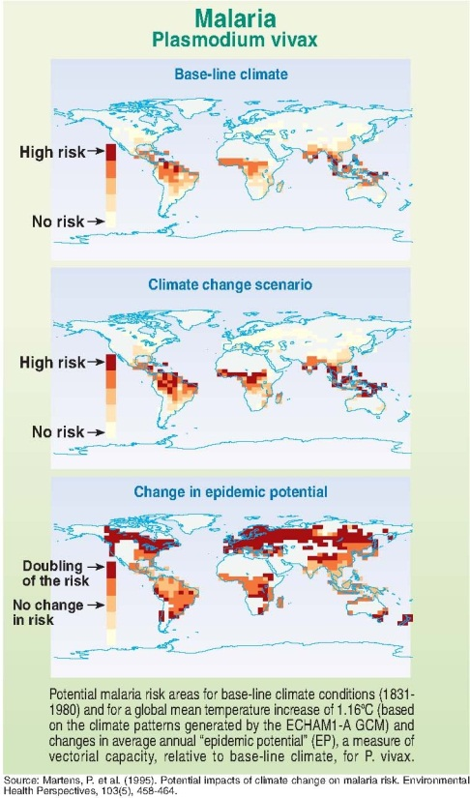
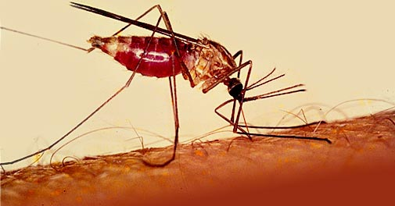
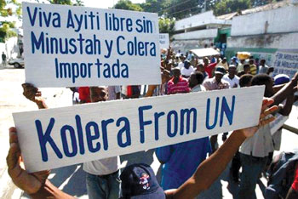

Infectious Disease & Public Health
Climate change affects vector range, behavior, and lifespan
Localized spikes in mortality vs. changes in baseline epidemiology
Disease affects military recruitment, readiness, and operability
Undermines the public’s confidence in their government
Notes:
Infectious disease responsible for estimate 25% of all human deaths! (more than war); hardest-hit is the developing world, has the least capacity
Malaria, dengue, yellow fever, sleeping sickness, leishmaniasis, hantavirus
Operability: UN peacekeeping troops from Nepal brought Asian strain of cholera to Haiti
Public health capacity generally underfunded; possibility of virgin-soil pandemic
[haven’t mentioned bioweapons, not climate-related]

Slide 18
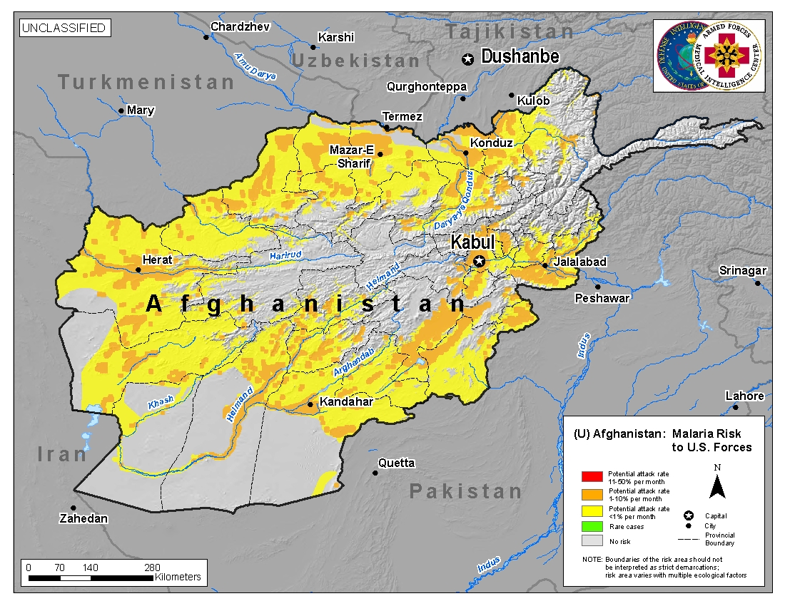

Slide 19
Environmental Security and
Future Engagement
What do we need to know?
How can Mad Scientists help?
Notes:
We need a new way of thinking.
Aldo Leopold articulated the “land ethic” – what if we applied this type of thinking to IR?

Slide 20

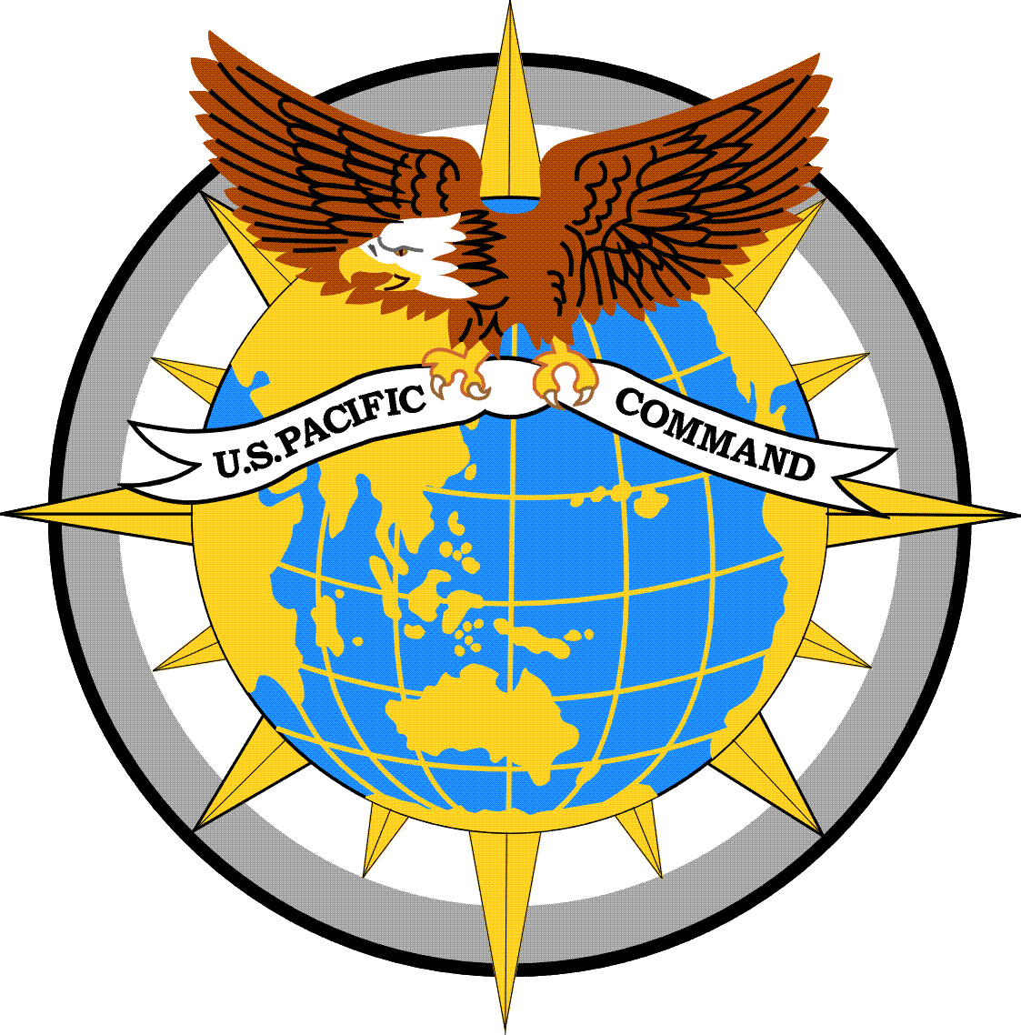
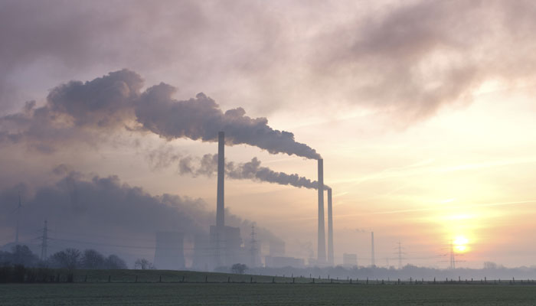
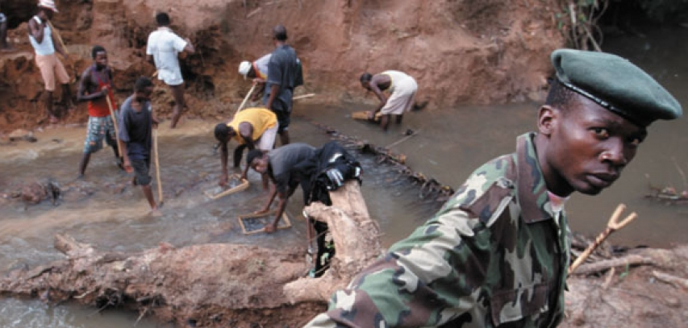
Persistent Environmental Security Issues
AFRICOM
PACOM
Drought across Horn of Africa
Infectious diseases such as Ebola
Continued food insecurity
Persistence of resource-driven conflicts
Food aid seized by insurgent groups
Increasing greenhouse gas emissions from China, India and other developing countries
Increasing demand for resources
Infectious diseases such as bird flu
Petroleum exploration in disputed seas
Continued migration

Slide 21
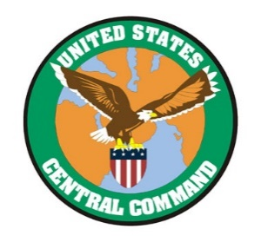

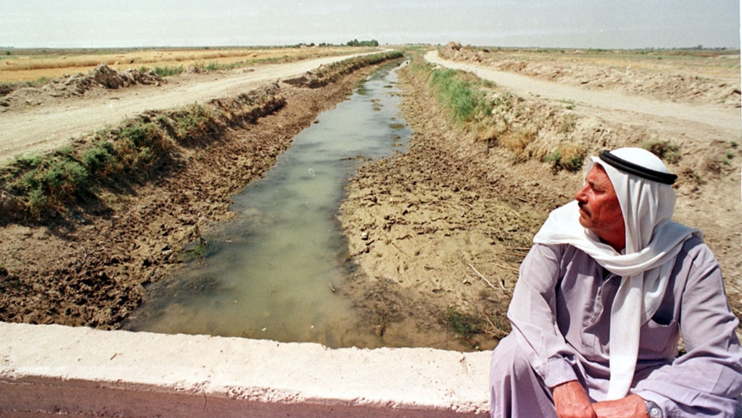
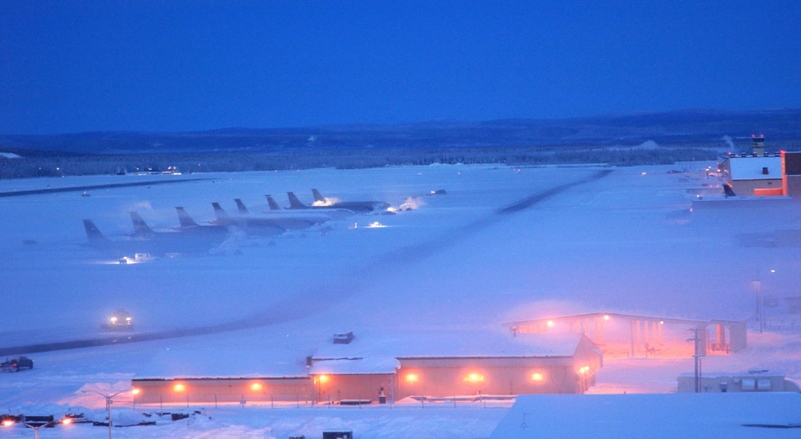
Persistent Environmental Security Issues
CENTCOM
NORTHCOM
Melting Arctic
Increased polar transit
Increased petroleum exploration and production
Infectious diseases such as Zika
More frequent droughts and water shortages
Continued food insecurity
Infectious diseases such as MERS
Vulnerable petroleum infrastructure

Slide 22
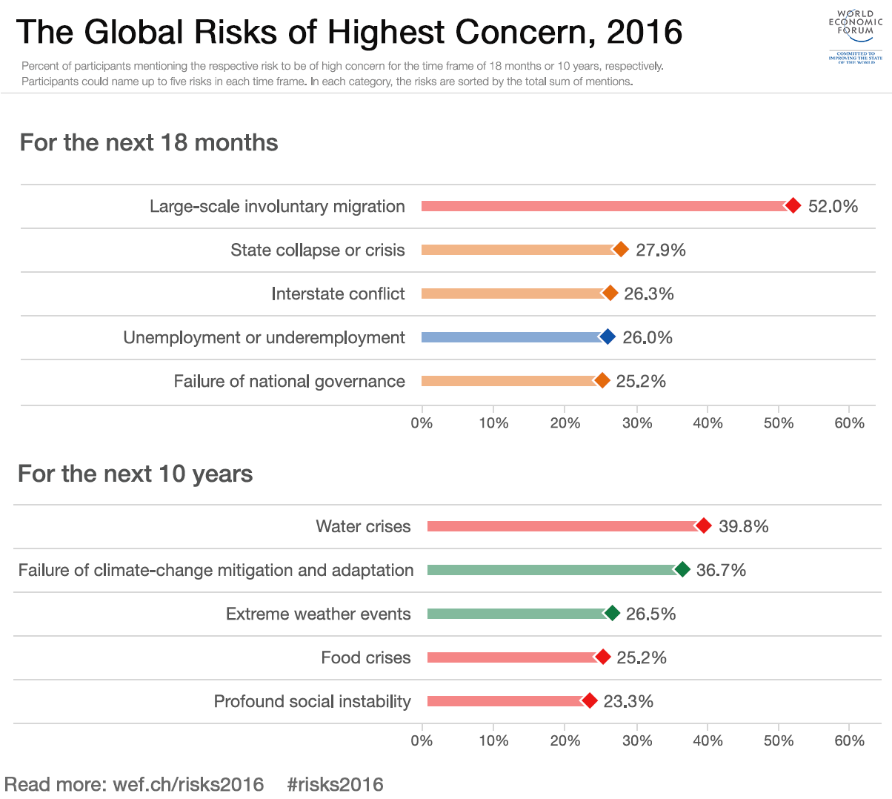
Environmental Security in 2050
Failure of food sovereignty contracts leads to regional conflict
Drought across northern China forces migration up into Russia
Russian de facto control of the Arctic causes geopolitical tensions
Resistance to de-carbonizing the global energy system pushes atmospheric CO₂ to 500ppm
Environmentalists will begin fighting back harder

Slide 23
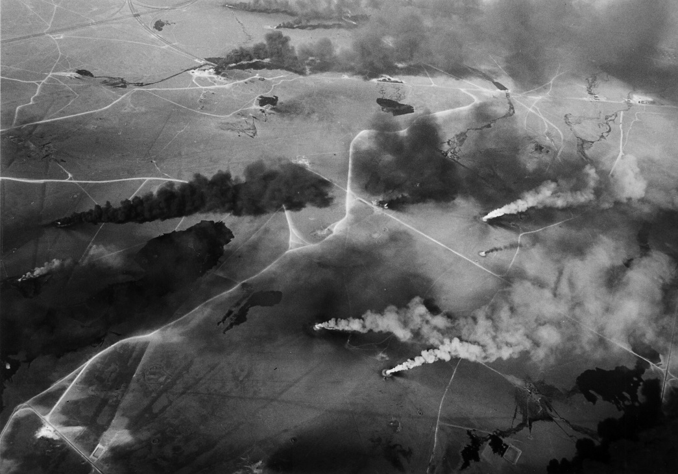
What ethical considerations does the environment deserve during war?
1977 Environmental Modification Convention
1977 Protocol I to the Geneva Convention
Principles of proportionality and discrimination
Fifth Geneva Convention?
Notes:
Some existing treaties ban or restrict particular kinds of weapons (CTBT) or in certain areas (Antarctic Treaty)
Proportionality = combatants can use the minimum amount of force necessary to achieve the security objective
Discrimination = all targets must have military or strategic value; cannot target non-combatants
ENMOD: prohibits hostile use of env. modification techniques; U.S. is a party
Protocol I: cannot conduct reprisals against civilians or their resources (food stocks, arable land, or water supplies); U.S. is not a party
Fifth Geneva Convention? Currently doesn’t exist, and operational conditions in a conflict make this difficult to enforce

Slide 24
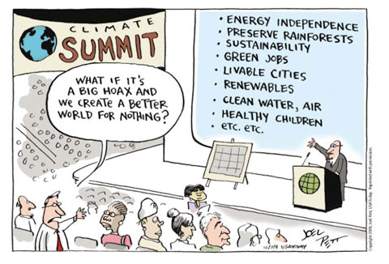

{ Thank You!

