Slide 1
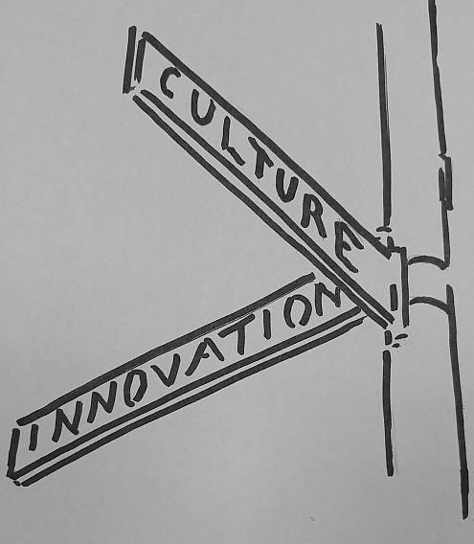
Practicing Design at the Intersection of Culture and Innovation
Mad Scientist Conference 2016
August 8th, 2016
Garth Jensen
Director for Innovation
Carderock Division, Naval Surface Warfare Center
mmowgli program director

Slide 2
Practicing Design at the Intersection of Culture and Innovation
Mad Scientist Culturalist Conference 2016
August 8th, 2016
Garth Jensen
Mad Culturalist

Slide 3
The Default View of Innovation
Possible
Infeasible
Accepted
SCIENCE
TECHNOLOGY
Marketplace
Impossible
Feasible
Rejected
innovation as the invention of new things or new ways of doing things

Slide 4
A More Complete View
Innovation as a Social (i.e. Human Centric) Phenomenon*
Unimaginable
Possible
Infeasible
Accepted
CULTURE
SCIENCE
TECHNOLOGY
Marketplace
Imaginable
Impossible
Feasible
Rejected
Adapted from the work of Gary Markovits , Pierre Levy, Peter Denning, Marina Gorbis
Notes:
Innovation as a Social (Human Centric) Phenomenon*
Innovation is the transformation of social practice in a community. It is not necessarily the same as the invention of a new object. The real work of innovation is in the transformation of practice.
In this definition, community can be small, as in a workgroup, or large as in the whole world. A transformation of practice in the community won't happen unless the new practice generates more value to the members than the old. Value may not be economic; it may be pride, reputation, health, safety, freedom, etc. Many innovations were preceded or enabled by inventions; but many innovations occurred without a significant invention.
Epi-Genetic Expression Analogy: genes expressing that wouldn’t have expressed otherwise

Slide 5
Adding Dynamic Feedback
Unimaginable
Possible
Infeasible
Accepted
CULTURE
SCIENCE
TECHNOLOGY
Marketplace
Imaginable
Impossible
Feasible
Rejected
Notes:
Why We Focus on Culture
Culture Determines What Is Imaginable
Culture Eats Strategy for Lunch
Culture Corresponds to the Store of Potential Energy*
each attempt at innovation feeds back into the culture…
…thereby opening the door of “the adjacent possible”*
…it only takes two “adjacent possible” jumps to become a new paradigm
* Adapted from Steven Johnson, Where Good Ideas Come From, The Natural History of Innovation
Focusing on Culture Is A High Leverage Activity

Slide 6
Stop Here for 5 Minute Presentation
Remaining Slides Are To Be Used If Needed During Q&A Session

Slide 7
An Operational Definition of Culture
……a collective phenomena……
…….an emergent property resulting from……
…..the systematic interplay between four elements

Slide 8
An Operational Definition of Culture
……a collective phenomena
…….an emergent property resulting from……
…..the systematic interplay between four elements
SHARED
TACIT
KNOWLEDGE
UNDERLYING
SOCIAL
NETWORK
COLLECTIVE
EXPLICIT
KNOWLEDGE
ACCEPTABLE
BEHAVIOR
PATTERNS

Slide 9
An Operational Definition of Culture
Mental Models
Analogies
Metaphors
Paradigms
Stories/Narrative
Craft
Skills
Knowhow
Undiscussables
SHARED
TACIT
KNOWLEDGE
UNDERLYING
SOCIAL
NETWORK
COLLECTIVE
EXPLICIT
KNOWLEDGE
ACCEPTABLE
BEHAVIOR
PATTERNS

Slide 10
An Operational Definition of Culture
Mental Models
Analogies
Metaphors
Paradigms
Stories/Narrative
Craft
Skills
Knowhow
Undiscussables
SHARED
TACIT
KNOWLEDGE
Written policies
Contracts
Guidelines
Process descriptions
Tools
Technologies
Equipment
Facilities
Business Rules
UNDERLYING
SOCIAL
NETWORK
COLLECTIVE
EXPLICIT
KNOWLEDGE
ACCEPTABLE
BEHAVIOR
PATTERNS

Slide 11
An Operational Definition of Culture
Mental Models
Analogies
Metaphors
Paradigms
Stories/Narrative
Craft
Skills
Knowhow
Undiscussables
SHARED
TACIT
KNOWLEDGE
Written policies
Contracts
Guidelines
Process descriptions
Tools
Technologies
Equipment
Facilities
Business Rules
UNDERLYING
SOCIAL
NETWORK
COLLECTIVE
EXPLICIT
KNOWLEDGE
ACCEPTABLE
BEHAVIOR
PATTERNS
Practices which implement policy
Social behaviors
Trust, reliability, truth, conviction
Patterns of Collaboration
Social Norms

Slide 12
An Operational Definition of Culture
Mental Models
Analogies
Metaphors
Paradigms
Stories/Narrative
Craft
Skills
Knowhow
Undiscussables
SHARED
TACIT
KNOWLEDGE
Written policies
Contracts
Guidelines
Process descriptions
Tools
Technologies
Equipment
Facilities
Business Rules
How Do Policies, Practices Affect the Health of the Network?
Growth v. Decline
Stable v. Unstable
Bridges & Long Links
Connected v. Unconnected
Inclusive v. Exclusive
Dense v. Thin
The Underlying Social Network as a form of Commons
UNDERLYING
SOCIAL
NETWORK
COLLECTIVE
EXPLICIT
KNOWLEDGE
ACCEPTABLE
BEHAVIOR
PATTERNS
Practices which implement policy
Social behaviors
Trust, reliability, truth, conviction
Patterns of Collaboration
Social Norms

Slide 13
Where Does Human Centered Design/ Design Thinking Fit In?
“Everyone designs who devises courses of action aimed at changing existing situations into preferred ones”…….Herbert Simon, Nobel Laureate in Economics
Looking: Observing Human Experience
Understanding: Analyzing Challenges and Opportunities
Making: Envisioning, Prototyping and Implementing Future Possibilities
we realized that we were in the business of Designing Cultural Interventions

Slide 14
Designing a Cultural Intervention

Slide 15
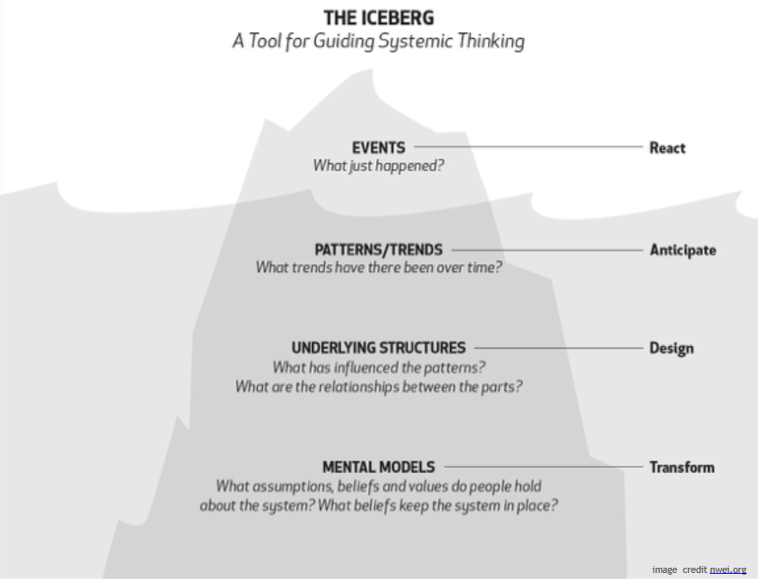
From Systems Thinking: Mental Models and The Principle of Leverage
Increasing
Leverage

Slide 16
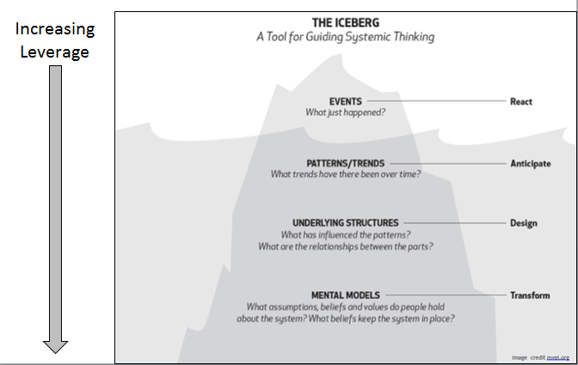
Deeply ingrained assumptions, generalizations, or internal images that influence how we understand the world and how we take action
Representations of reality that we carry in our heads
Necessary simplifications……..a map of the world
Our Mental Models determine how we make sense of the world, how we organize and take in information and also how we take action
A type of “filter” on the “data” we take in
Einstein: our theories determine what we measure

Slide 17
Often we are not consciously aware of our Mental Models or their effects on behavior
Mental Models usually operate at the tacit level – below the level of awareness
The issue is not whether our Mental Models are “right” or “wrong” – by definition all models are simplifications
All models are wrong, some are useful
We need Mental Models to survive and operate in the world. To this extent, they are useful.
However, our Mental Models can also limit us to familiar ways of thinking and acting
The issue is whether our Mental Models remain below the level of awareness and thus remain unexamined and unchallenged

Slide 18
Why This Matters
Sometimes, The Best Ideas Fail To Get Put Into Practice
New insights often fail to get put into practice because they conflict with our existing Mental Models
The real leverage lies in learning how to manage and being intentional about managing our Mental Models
Surfacing, testing, making EXPLICIT, that which is currently TACIT

Slide 19
A Working Definition of Culture
Mental Models
Analogies
Metaphors
Paradigms
Craft
Skills
Knowhow
Undiscussables
SHARED
TACIT
KNOWLEDGE
Written policies
Contracts
Guidelines
Process descriptions
Tools
Technologies
Equipment
Facilities
Business Rules
How Do Policies, Practices Affect the Health of the Network?
Growth v. Decline
Stable v. Unstable
Bridges & Long Links
Connected v. Unconnected
Inclusive v. Exclusive
Dense v. Thin
The Underlying Social Network as a form of Commons
UNDERLYING
SOCIAL
NETWORK
COLLECTIVE
EXPLICIT
KNOWLEDGE
ACCEPTABLE
BEHAVIOR
PATTERNS
Practices which implement policy
Social behaviors
Trust, reliability, truth, conviction
Patterns of Collaboration
Social Norms

Slide 20
The Underlying Social Network
D
C
Individuals – Possess the tacit knowledge
Networks – Enable the opportunity to share
Challenges – Provide the motivation to share
Trust – Determines the willingness to share
A
B
The Underlying Social Network creates and bounds the organization’s social capital
Social capital is the stock of active connections among people: the trust, mutual understanding, and shared values and behaviors that bind the members of human networks and communities and make cooperative action possible. “In Good Company” - Cohen & Prusak

Slide 21
The Role of Network Structure
Structural links are paths by which knowledge or technical expertise flows formally
Relational links are social interactions built on inter-personal trust
Organizations are socio-technical networks
Both types of links are necessary

Slide 22
What Do We Mean By Design?
“Everyone designs who devises courses of action aimed at changing existing situations into preferred ones”…….Herbert Simon, Nobel Laureate in Economics
Looking: Observing Human Experience
Understanding: Analyzing Challenges and Opportunities
Making: Envisioning, Prototyping and Implementing Future Possibilities
Iterative and Recursive………………….NOT………………………..Linear and Serial

Slide 23
Designing Your Cultural Intervention Start Anywhere on the Culture Wheel
Mental Models
Do We Understand The Current Mental Model?
Can We Articulate It and Make It Explicit?
Does Our Cultural Intervention Conflict With the Current Mental Model?
If So, What Needs To Change About The Current Mental Model?
The Underlying Social Network:
Does this Intervention support social networks that
Grow organically?
Motivate members?
Remain stable over time?
Expand Your Definition of Prototype
Policy Can Be A Prototype
Pilots/Prototypes De-Risk A “Radical” Idea In the Eyes of Decision Makers
Prototypes Elicit Tacit Knowledge from End Users
What Is the Minimum Viable Prototype for My Cultural Intervention?
How Soon Can I Pilot It? At What Scale?
What Information Would I Collect Around the Pilot?
Cheap Experiments Are Worth More Than Good Ideas

Slide 24
A Running List of Cultural Interventions
Education and Training: Since February 2015 We Have Sent
25 People to OPM-Human Centered Design Course
Two People to RISD/State Dept Bootcamp for Design + Public Policy
Two People to Inaugural White House Interagency Meeting on Design + Public Policy
What Those People Have Done
Digital-to-Done: Investment Strategy (results briefed to senior leadership)
Applying Boyd’s OODA Loop to Organizational Decision Making (initiated, partially scaled)
A Longitudinal Study of the New Hire Bridge Program (initiated, piloted)
Addressing the Non-Linear Cost of Bank Card Compliance (initiated)
A Systems Dynamics Based Dashboard for Business Processes (initiated)
Using milsuite for Technical and Administrative Collaboration (initiated, piloted, scaled, and recognized for excellence outside the Command)
Adapting the “Shark Tank” Model for Internal S&T Investment (initiated, piloted)
Developing a Human Centered Design Toolkit for the Workforce (initiated)
Co-developing an Advanced Warfighting Concept using Virtual Worlds (prototyped)
Innovation Café: “How Might We Measure Innovation at Carderock?” (initiated, scaled)
Formulating a Long Range S&T Plan (in process, using the Innovation Café model)
Big Data: What It Affords Us/What It Requires of Us (still in process)
Academic Outreach Day (event conducted, results being processed)
Two Submissions Published at White House Interagency Meeting on Design + Public Policy

Slide 25
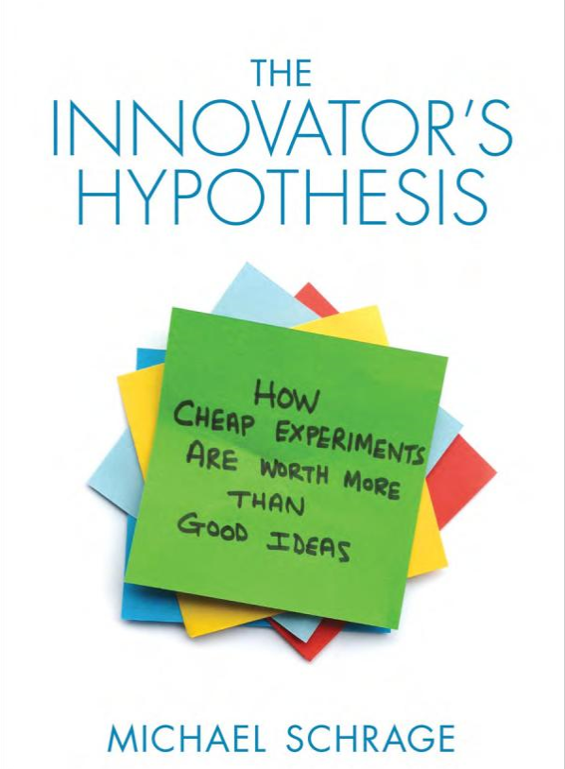

Slide 26
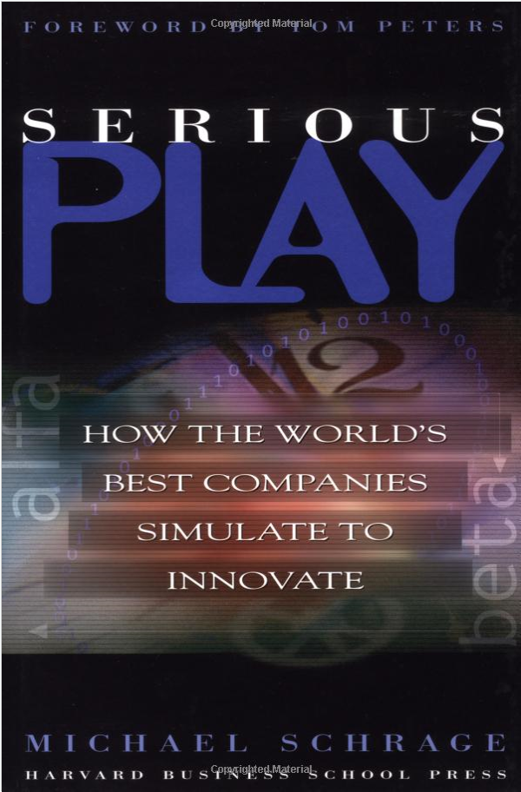

Slide 27
A More Hands On Approach : All Projects
At every check-in we will be pushing you to think through
Who is/are my end-user(s)? Who are my stakeholders? How well do I know their needs? Articulated and unarticulated? How can I get to know them/their needs better?
What would a minimum viable prototype look like that I can place in their hands and exercise?
How soon can I do that? How many times can I do that?
Expand your definition of prototype
Use the prototype to produce learning and to elicit tacit knowledge

Slide 28
Serious Play and A Culture of Prototyping Michael Schrage
Forward, Tom Peters
Central thesis: organizations manage themselves by their prototypes.
Will we get more value from better managing our innovation process to get a prototype? Or from better using our prototype to manage our innovation process?
Innovative prototypes generate innovative teams
Good prototypes invite dialogue versus truncating debate……
Preface
Not enough to have a brilliant idea…have to be able to demo them. Have to get people to want to play with them.
You know you have a good idea when people go beyond compliments and start suggesting ways to make it better, or when sponsors can use your demo as a platform for their own work.
The key to successful collaboration is the creation and management of shared space. (DIAGRAM). Transactional model of comms vs collaborative model of comms.
Prototypes as a form of shared space
Your prototyping culture shapes your innovation processes
The nouns shape the verb
Innovation is more social than personal, a by-product of how well we play with others. Behavior, not knowledge drives innovation.

Slide 29
Serious Play and Culture of Prototyping, p2
Preface (continued)
A journey from ethnography to ethology
Our brains are wired as much for the manipulation of social relationships as for management of rational thought (Robin Dunbar and other evolutionary anthropologists)
How prototypes are designed and used are functions as much of arational human interactions, as they are a product of rational analyses.
This book is not a plea for more rational management of modeling….
Serious play as a core competence. Treating prototypes as conversation pieces.
From Fierce Conversations, Susan Scott: the conversation is the relationship
From Leaders make the future: Commons Creating (i.e. shared space): the ability to seed, nurture and grow shared assets that can benefit other players – and sometimes allow competition at a higher level. Commons creating is the ultimate future leadership skill. New commons are shared resources that create platforms for generating wealth and value.

Slide 30
Serious Play and Culture of Prototyping, p3
Overview
When talented musicians improvise, you don’t look inside their minds, you listen to what they play. When talented innovators innovate, you don’t listen to the specs they quote, you look at the models they have created.
The notion that innovations can be studied or analyzed into existence flies in the face of history and fact
Models, prototypes and simulations are the most important media for innovation
Changing the economics of play transforms the economics of innovation. And when innovation economics change, so do individual and institutional behaviors. Play is more about behavior than about thought
Models and the user interactions with the prototype often generate results utterly at odds with the assumptions embedded in them. They can be engines of surprise.
We shape our models and then our models shape us.

Slide 31
Naive Rationalism, Taleb on page 348 of Anti-Fragile
Let me repeat the argument here in one block to make it clearer:
Evolution proceeds by undirected, convex bricolage or tinkering, inherently robust, i.e. with the achievement of potential stochastic gains thanks to continuous, repetitive, small, localized mistakes.
What we have done with top-down, command and control science has been exactly the reverse: interventions with negative convexity, i.e. the achievement of small but certain gains through exposure to massive potential mistakes. Our record of understanding risks in complex systems is pitiful.

