Slide 1
2015 Marine Corps Security Environment Forecast Briefing for Army Mad Scientist
8 August 2016
Briefer: LtCol Patrick Kirchner
Foresight Analyst Futures Assessment Division
Point of Contact: LtCol Patrick Kirchner
(703) 784-5479
patrick.kirchner@usmc.mil
Version: 201600801 (1000)
DISTRIBUTION STATEMENT A: Approved for public release; distribution is unlimited

Slide 2
Futures Assessment Division
Futuring/Foresight (Us)
15-30 years
Expands
Speculative
Absorbs massive amounts of data and expands it to consider possibilities
Intelligence (Them)
Now – 10 years
Reduces
Seeks certainty
Reduces massive amounts of data into the certainty that can be obtained
Assess plausible future security environments; generate ideas; and provide recommendations for service consideration IOT guard against strategic surprise, shape the future force, stimulate thought and debate, and inform senior leadership.

Slide 3
Foresight Network
Partners & Allies
Academia
Other Agencies
GFF
Shell
FAD
Think Tanks
ONA
AF/SSG
Future Concepts
Joint Staff J5/J7
ARCIC
SSI/SSG
CNO SSG
CJSIG
3

Slide 4
Trend Selection
What is everyone else writing about?
What if they’re wrong?
Is it important to the Marine Corps?
Does it affect Manpower, training, equipment?
Does it highlight some aspect of the enemy or the environment to which we will have to respond?

Slide 5
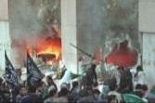
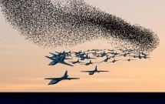
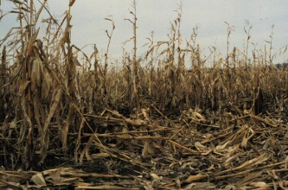
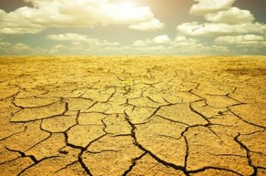
MCSEF Trends and Drivers
DEMOGRAPHICS
GOVERNANCE
URBAN LITTORALS
TECHNOLOGY
GLOBALIZATION
RESOURCE COMPETITION
ENVIRONMENTAL STRESS
5

Slide 6
Future Worlds Overview
Future | Name | Primary Characteristics
Baseline | World in 5-D Multiplex | - Traditional U.S. advantages marginalized - Rise of the megacity - U.S. defers leadership to multinational organizations
Alternative A | Global Water Crisis | - Widespread water scarcity drives migration toward urban centers, stressing infrastructure - More HA/DR requests than the U.S. can handle
Alternative B | Multi-polar World | - Diffusion of ruin-causing knowledge and A2/AD - Stagnant US economy & tech development - Limited military engagement
Preferred | World Accommodating | - Rules-based international order - US dominance despite near-peer competitors - Increasing interdependence of global economy

Slide 7
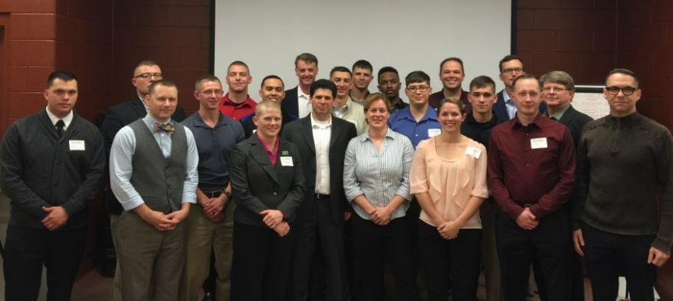
Articulating MCSEF Worlds
February 2016 Science Fiction Futures Workshop
Atlantic Council Art of the Future Project (http://artoffuturewarfare.org/)
Authors / Coaches
August Cole (Ghost Fleet w/ Peter Singer)
Chuck Gannon (Caine Riordan series)
Max Brooks (World War Z)
18 Uniformed Service Members
To be released late Summer 2016
Purpose
Convey the Future to the masses
Wargaming

Slide 8
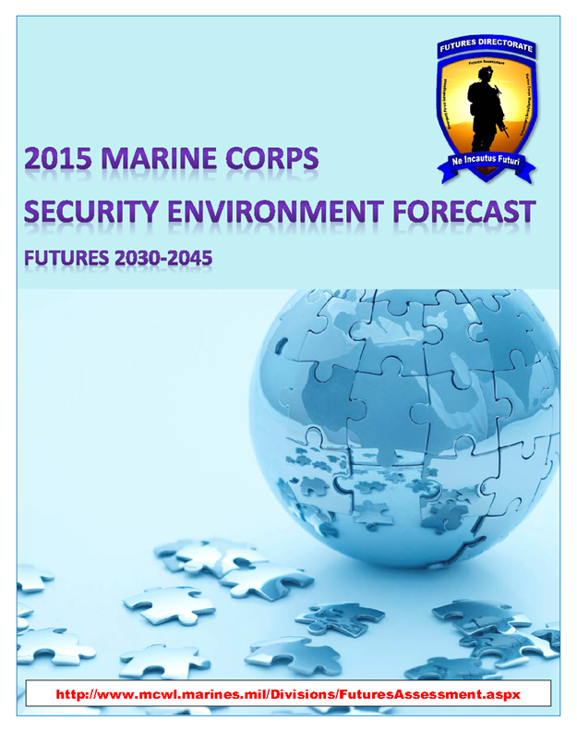
Questions?
Find the complete forecast at:
www.mcwl.marines.mil/
Sign up for Notes from the Edge: MCCDC_STRAT_Vis_Grp@usmc.mil

Slide 9
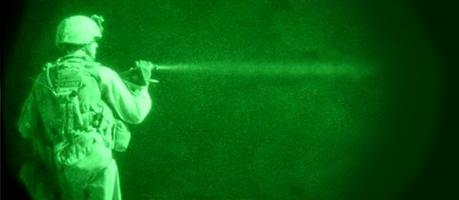
Assessing Plausible Security Environments
Preferred Futures
Baseline Futures
Plausible Futures
Possible Futures
Alternative Futures
NOW
TIME (+15-30 YEARS)
Intel

Slide 10
Creating Alternative Futures
Trend variance: Shock (Black Swan, etc…)
Trend variance: Slope acceleration/retardation
Alternative Future “A”: - Inter-/Intra-national Migration - Water scarcity exacerbated
Alternative Future “B”: - Medical technology advancements - Decline in funding for basic research - Democratization of ruin-causing knowledge
Methodology: BOGSAT, post formal research

Slide 11
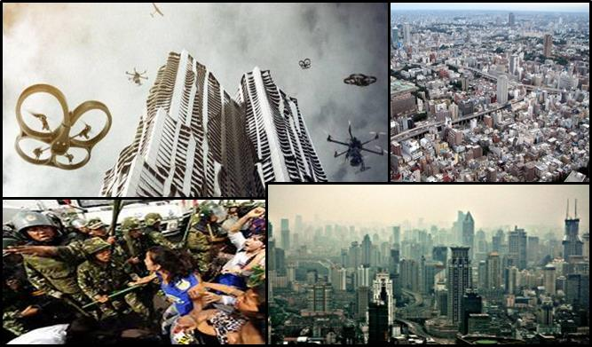
Baseline Future: World in 5-D Multiplex
Complex intermingling of people, economics, & interests
Numerous power centers within the city (ethnic, economic, crime, etc)
Chronic food & water shortages
“Three Floor Wars”
Reliance on unmanned systems
Multinational responses
Implications
Magnification of localized power through alliances, S&T, & masses of people
Ubiquitous observation, tracking, & targeting of US forces and activities
Extreme complexity of military aspects of terrain (KOCOA)
360 degree maneuver, threats, & angles of fire
Notes:
These several slides are built to summarize the projected “world”, highlight some aspects of the PMESII construct, then on the second slide, describe the US role in that world.
-------------
Drawing out the previously discussed patterns and trends to the their logical extension gives us the baseline future.
In this multipolar world beyond 2030, a large region of the globe, termed the “Arc of Instability”, which many of you are probably familiar with, has continued to suffer from a complex combination of factors leading to local and regional political instability, social unrest, and conflict.
This part of the world has suffered earthquakes, tsunamis, disease outbreak, and other natural disasters in increasing number and severity, exacerbated by climate disruption and human littoral density.
The United States and its partners face near-peer state actors, as well as more sophisticated non-state actors empowered by the proliferation of technology and information. They make use of cheap and readily available state-of-the-art technologies such as 3-D printing, inexpensive precision location and targeting capabilities, cyber tools, biological and chemical weapons, and autonomous air, land, and sea vehicles.
Weak governance of the megacities and surrounding peri-urban slums has generated shadow governments: local gangs, crime syndicates, and terrorist organizations that provide a semblance of alternate governance, but exploit the population.
In the 1990’s, General Krulak saw the potential future Marines would conduct full scale combat operation, peacekeeping missions, and humanitarian aid within the space of three contiguous city blocks.” He called it the “three block war.” This could soon occur vertically, on three Floors in a Mega Skyscraper vice city blocks, and not necessarily three contiguous floors, or even adjacent buildings.
Conflict takes place in dense, complex urban settings, in, about, and amongst the people, and you can’t kill them. The enemy is as likely to use sophisticated autonomous sensors or drones as they are to use relatively primitive IEDs or Molotov cocktails.
That’s the baseline future. Now, we take that world and vary a couple of the trends to get the first alternative future. We rapidly accelerate the trends of resource scarcity, specifically fresh water shortage, and eco-migration and it gives us alternative world A [Slide]

Slide 12
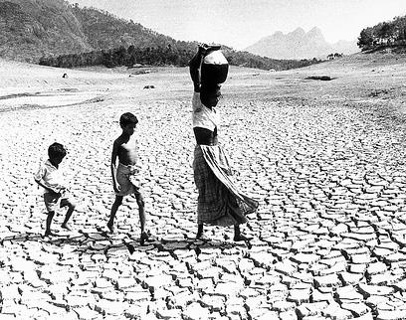
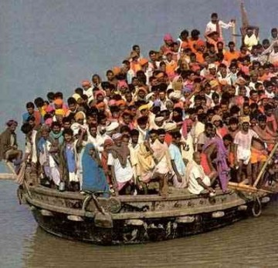
Alternative Future A: Global Water Crisis
Global water crisis
Desertification due to poor land and water management and intense weather systems
Accelerated migration patterns
Rapid population expansion in coastal megacities has overwhelmed infrastructures
Implications
U.S. still the global leader, but overwhelmed by own water crisis and inability to manage absorption of immigrants
Water competition between industrial and individual users
Abandoned areas without economic tax base
Notes:
In alternative Future A, the world is affected by the overwhelming lack of fresh water. The developed world is keenly aware of its daily water usage, while the developing world may go days without access to fresh water. This drives international migration as populations seek relief. Unfortunately, their destinations’ infrastructures become quickly overwhelmed.
The U.S. is not unaffected by this crisis. The Southwest, from Texas to California, under strict water rationing, forces water-intensive industries to relocate to the Midwest. While the Midwest experiences an industrial rebirth, the Southwest is left with drained aquifers, wasted and abandoned dryland farms, and no tax base to sustain local governments and infrastructure.
The U.S. becomes internally focused. It is an even greater destination for migration, forcing heightened efforts to restrict borders and strictly manage immigration and immigrant populations.
Fresh water scarcity and overwhelming international migration, which at times overstress the coping capabilities of recognized governments, provide non-state actors with opportunities to become viable alternatives to traditional governance. International requests for assistance, in the form of HA/DR, come in faster than the U.S. can handle them. Frequently, response is limited to planning and technical assistance.
Despite the widespread availability of technology and information which can optimize water conservation efforts, cultural norms and agricultural traditions in the hardest hit areas are difficult to overcome, and those regions continue to suffer.
-----------
That is the essence of the first alternative future. To get the second one, we re-set the original trend trajectories in the baseline and choose others to vary. [Slide]

Slide 13
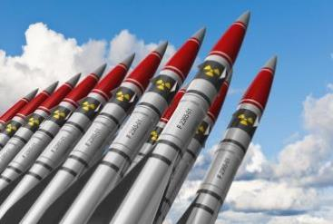
Alternative Future B: Multi-Polar World
A stagnant U.S. economy limits National research funding and innovation
Democratization of Technology
Proliferation of biological weapons and A2/AD technology
Diffusion of ruin-causing knowledge
DNA-based remedies and illnesses
Implications
Average American life expectancy is in the 90s
Growing entitlement costs overwhelm economy
Nations turn to China for technological innovations
Fear of bioengineered viruses hinder urban growth, military deployments
Notes:
Alternative Future “B” is a Multipolar World with Declining U.S. funding for Basic Research and the spread of Ruin-Causing Knowledge.
A stagnant U.S. economy, federal budget cuts, and the rise of competitors have had a crippling effect on the U.S. position in the world. The Nation has decreased its basic research funding. This research is the type which brought you the Google algorithm, touchscreen technology, the internet, and GPS. This permits competitors to catch up to and perhaps surpass the U.S. Both State and non-state actors increasingly opt to invest in technology over more costly personnel.
Globalization and the democratization of technology give rise to a world in which anti-access / area denial technology is readily available to smaller countries at a very low barrier to entry.
The world finds that technology and knowledge developed with beneficial outcomes in mind are being “hijacked” for nefarious ends. Technological advancement and proliferation have made biological weapons more affordable and available.
There is good news: Significant medical breakthroughs are prolonging life and enabling advances in DNA-tailored remedies. The average lifespan in the developed world is in the 90s. The result is that extended life puts a further stress on social welfare programs, crowding discretionary spending to less than 20% of the already flagging U.S. Federal budget.
The ubiquitous threat of custom-engineered weapons, as well as the United States’ inability to maintain an advantage in this arena, has forced the Nation to hunker into a protective isolation. Forces are only forward deployed in areas required by treaty, and only when U.S. interests are directly threatened does the Nation step out to get involved.
My brother described this world as particularly dystopian.

