Slide 1
Chancellor William McRaven “You Can’t Get to Greatness by Being Timid.”

Slide 2
The higher education landscape is shifting under our feet
Alternative providers: Corporate providers: Microsoft Corporate universities: Deloitte University Technology educators: General Assembly
University-Corporation Partnerships: Arizona State-Starbucks
ONLINE EDUCATION Georgia Tech
NEW EDUCATIONAL MODELS Co-location of universities and industry Combining classroom-based learning and practical work experience Freemium models

Slide 3
Our Options
Play offense
Play defense
Stand on the sidelines

Slide 4
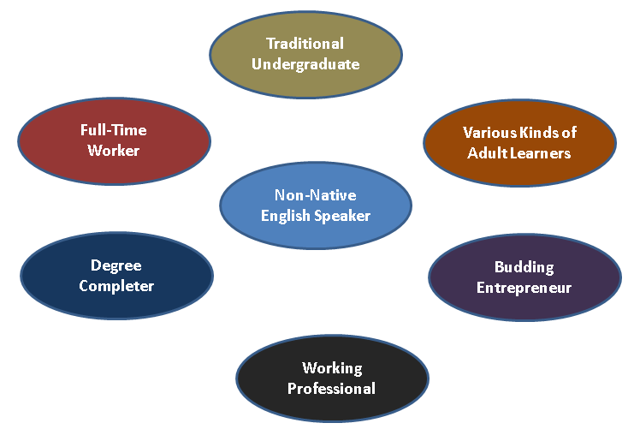
The Student Success Challenge
The Challenges
Student bodies increasingly consist of populations that higher education has poorly served

Slide 5
The Challenges
The Student Success Challenge
The New Student Majority
The new student majority is older, self-supporting, diverse, and has work and family responsibilities
25 and older | 36%
Self-supporting | 47%
Enrolled in a 2-year institution | 40%
Attends part-time | 46%
A member of a minority group | 36%
A low-income student | 40%
Works part-time | 43%
Works full-time | 32%
A parent | 23%
A single parent | 13%
25 and Older | 36% | Low Income | 40%
Independent Student | 47% | Work Part-time | 43%
Enrolled in 2 Year School | 40% | Work Full-time | 32%
Part-Time Student | 46% | Parent | 23%
Minority Student | 36% | Single Parent | 13%

Slide 6
The Challenges
The Student Success Challenge
The United States has among the least efficient post-secondary education systems in the developed world.
Fewer students graduate
Time to degree is longer
Student debt is larger
Post-graduation entry into a career is slower
Most graduates find work in areas not strictly related to their degree

Slide 7
The Challenges
The Student Success Challenge
The pipeline to a degree is extremely leaky

Slide 8
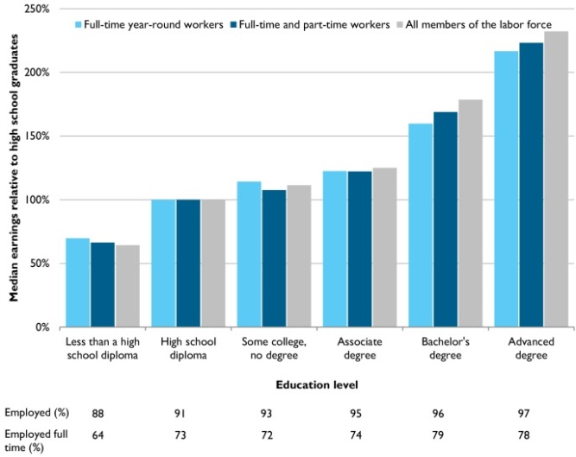
The Challenges
The Student Success Challenge
The financial payoff from a college degree has never been greater

Slide 9
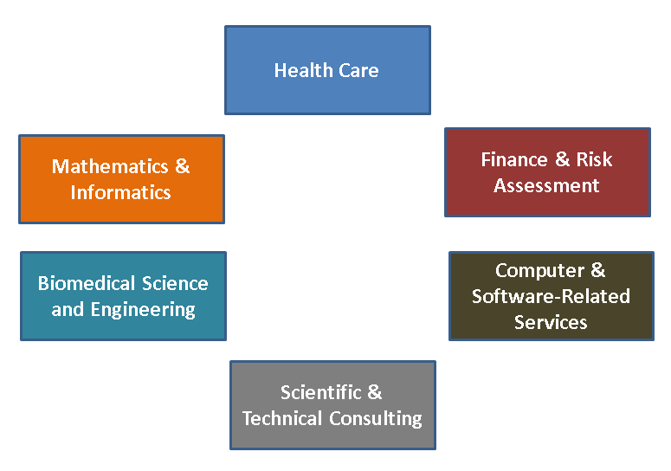
The Challenges
The Student Success Challenge
The job sectors with the highest growth rates and median incomes require STEM training

Slide 10
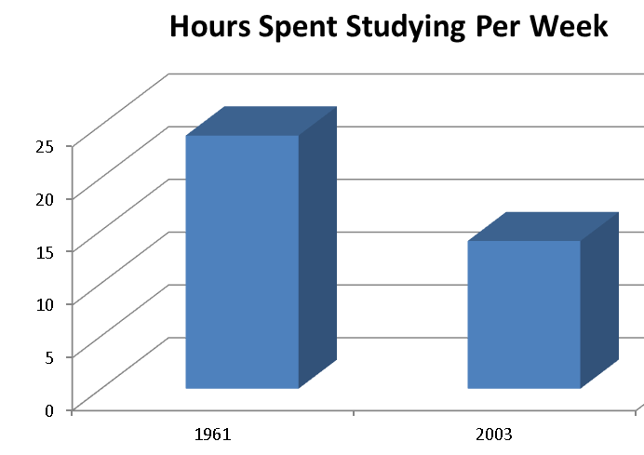
The Challenges
The Learning Outcomes Challenge
The time students spend studying has declined sharply over time

Slide 11
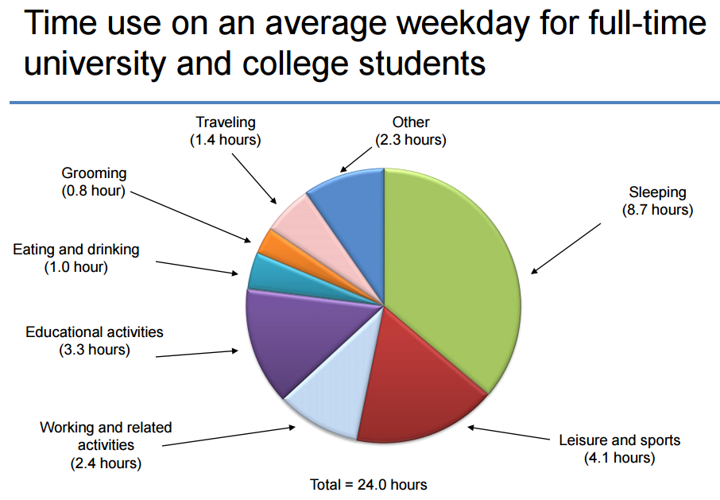
The Challenges
The Learning Outcomes Challenge

Slide 12
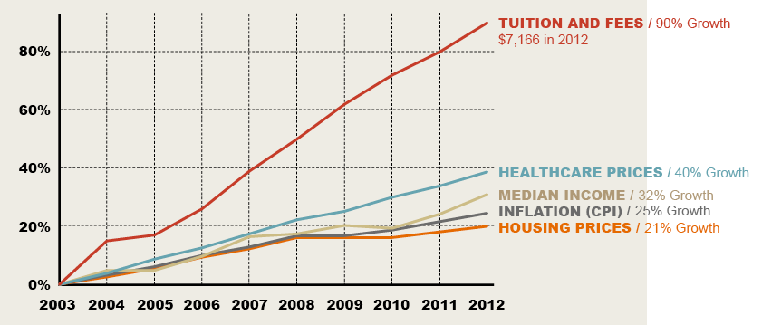
The Challenges
The Cost Challenge
Tuition and Fees in Texas Public Universities, 2003-2012

Slide 13
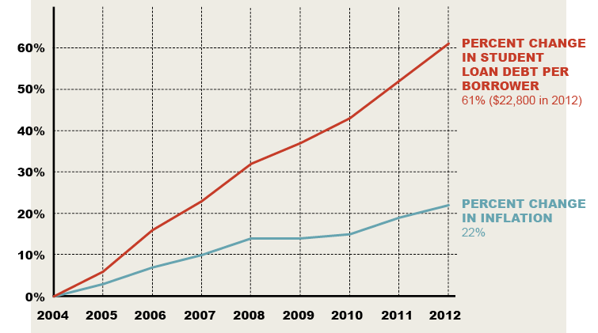
The Challenges
The Cost Challenge
Student Debt in Texas, 2004-2012

Slide 14
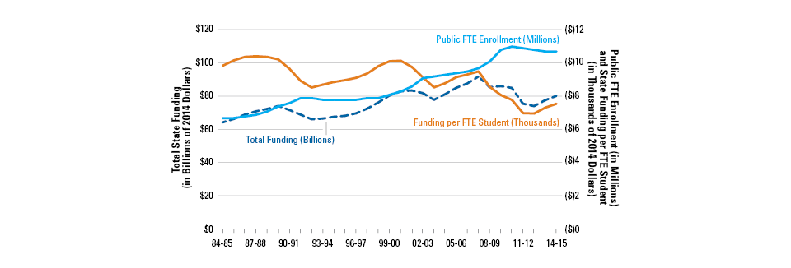
The Challenges
The Business Model Challenge
State funding per student at public universities has fallen sharply forcing institutions to find other sources of revenue

Slide 15
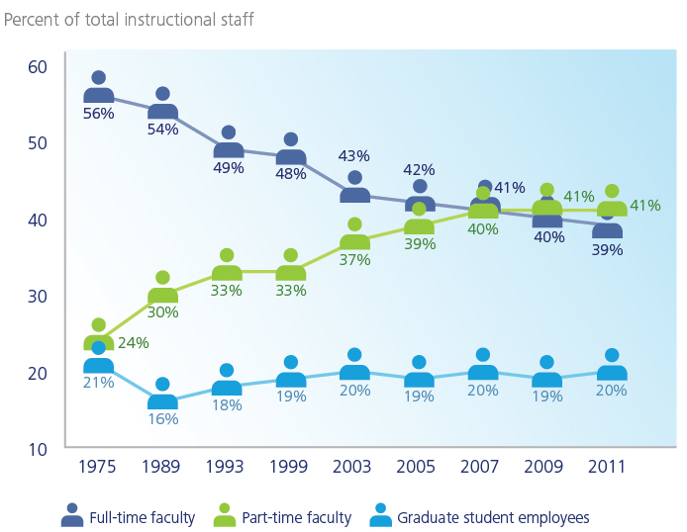
The Challenges
The Business Model Challenge
To save money, institutions rely increasingly on part time faculty

Slide 16
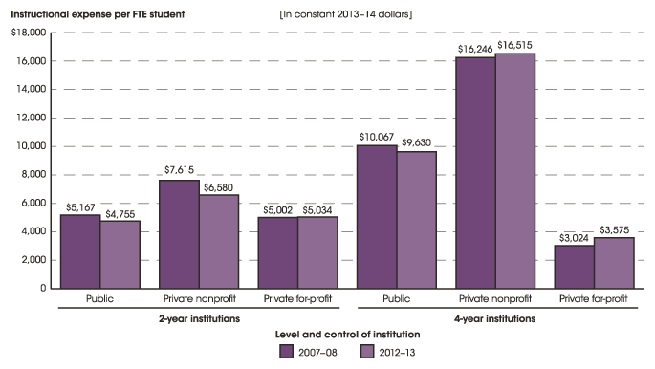
The Challenges
The Equity Challenge
There is an inverse relationship between instructional spending and student needs

Slide 17
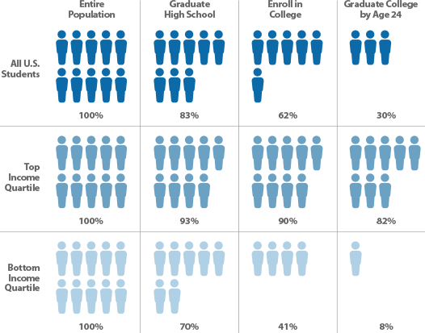
The Challenges
The Equity Challenge
Family income is the best predictor of graduation rates

Slide 18
A New Educational Paradigm From an Industrial Age to an Information Age Model
From: | To:
A mass production, one-size-fits-all model | A personalized approach to education
A transmission model | Interactive forms of learning
A sink-or-swim approach | A goal of bringing all students to proficiency
A lone-eagle approach to course design | Collaborative design of courses

Slide 19
A New Educational Paradigm Innovative Educational Pathways
New Avenues to Success
Verticals | Degree pathways that begin in high school
Stackable Credentials | Modules and certificates that can lead to degrees
Work to Learn | Credit for prior learning
Coop | Education that combines learning and work experience
Military Crosswalk | Credit for military training
Competency-Based | Credit based on mastery, not seat time
Open Loop | Lifelong learning opportunities

Slide 20
Chancellor William McRaven “You can’t get to success by being timid”
Through the Institute for Transformational Learning, our campuses are taking bold steps to advance Texas’s human capital and prepare many more Texans to thrive in the rapidly changing world of work….
The ITL works closely with faculty across the System to implement future models of education that disrupt every facet of the learning experience….
I consider the ITL to be the UT System’s innovation arm. The ITL is a crucial tool in bringing growing numbers of Texans to success in their careers and their lives.

Slide 21
The ITL Approach Reengineering every facet of the learning experience
We use design principles and the science of learning to create
An integrated curriculum with well defined learning outcomes and a clear value proposition.
A digital learning experience that is personalized, gamified, and highly social.
High-impact pedagogies that are inquiry-driven and challenge-based and that feature bilingual content.
Wrap-around student services.
Flexible delivery formats and schedules.
Fine-grained learning analytics and dashboards

Slide 22
In partnership with faculty across the UT System, the ITL is creating:
Breakthrough pathways to student success In the health sciences, computer science, and engineering that can begin as early as high school.
Next Generation Educational Infrastructure Including TEX, our state of the art digital learning, student services, and analytics platform, and the UT Learning Cloud, our systemwide provider of online learning.
Wrap-around support services and advanced learning analytics To drive dramatic increases in student learning and post-program success.

Slide 24
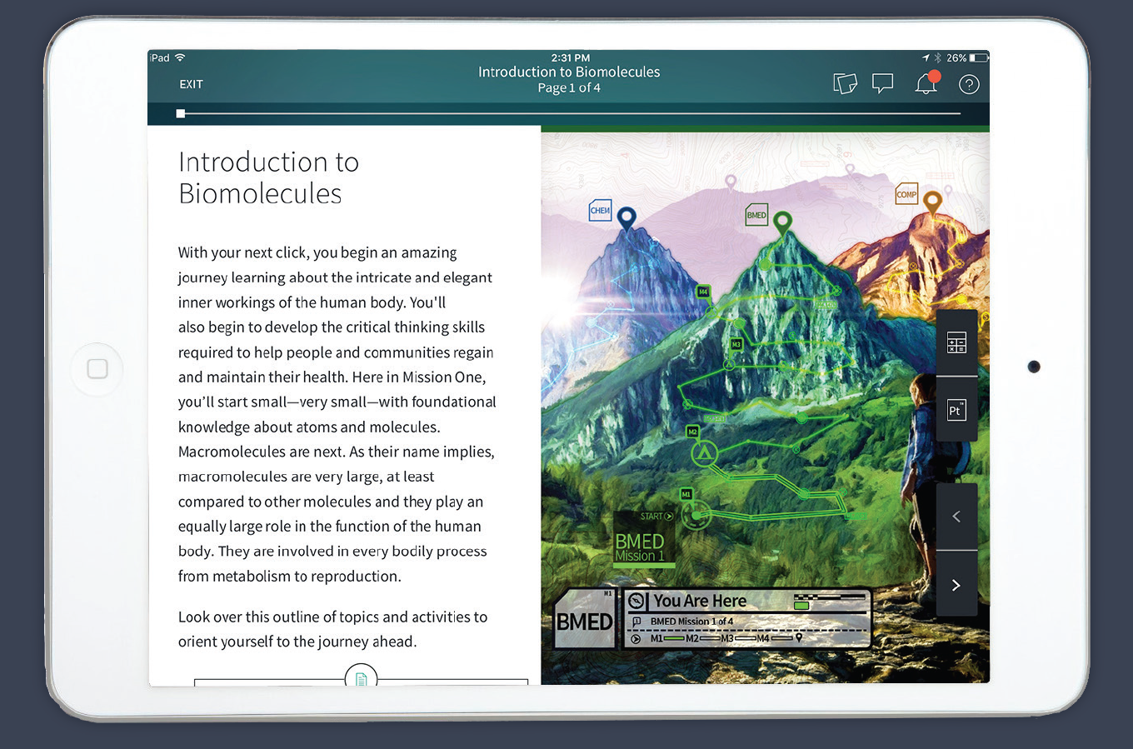
A step beyond today’s course-centered Learning Management Systems
Introducing TEx

Slide 25
TEx Our next generation digital learning platform
TEx supports:
Competency-based, modularized, gamified, variable-paced, and termless learning.
Personalization of pace, content, and learning trajectories.
Immersive, interactive content and advanced simulations.
Personalized enrollment, advising, and coaching services.
Communities of learners who can participate in collaborative projects and problem-solving activities.

