Slide 1
Cybersecurity Host Nation Strategy Development Coalition Engagements
Stanley M Wanklyn
J69 ISSM Cybersecurity Lead
Cyber Coalition Engagements
U.S. Africa Command
05 May - 06 May 2021

Slide 2
Introduction
Introduction:
The purpose of Cybersecurity engagements and cooperation with our host nations is to facilitate discussions on the purpose of Cybersecurity strategies and methodologies for securing host nations infrastructures against hostile foreign actors, and to develop strategies that will bolster our partnerships, instill unilateral trust, and information sharing capabilities.
Here are a few examples of the methodologies we employ:
Cyber Strategy Development at the National and Military Levels
Cybersecurity host nation in country assessments
Cybersecurity Workforce Training and Retention Deployment
Rapid Deployment Technology Tool Set i.e. for Cybersecurity Operation Center (CSOC) or Fusion Center types of operations
Information Sharing on Adversarial behavior using globally accessible knowledge bases i.e. MITRE ATT&CK

Slide 3





The Cross-Cutting Importance of Cyber Strategy
Operational, business, logistical, financial and social transactions all depend on cyberspace
Cyber capability, security, and capacity are vital national and organizational interests
Missions/Businesses depend on effective cyber strategies to maintain security of key components

Slide 4
US National Cyber Strategy
Protect the American People, the Homeland, and the American Way of Life
  Secure Federal Networks and Information
  Secure Critical Infrastructure
  Combat Cybercrime and Improve Incident Reporting
Promote American Prosperity
  Foster a Vibrant and Resilient Digital Economy
  Foster and Protect United States Ingenuity
  Develop a Superior Cybersecurity Workforce
Preserve Peace through Strength
  Enhance Cyber Stability through Norms of Responsible State Behavior
  Attribute and Deter Unacceptable Behavior in Cyberspace
Advance American Influence
  Promote an Open, Interoperable, Reliable, and Secure Internet
  Build International Cyber Capacity

Slide 5
U.S. DoD Cyber Strategy ― Objectives
Ensure ability to conduct missions in a contested cyber environment
Conduct cyber operations that enhance U.S. military advantages
Defend U.S. critical infrastructure from malicious activity that could cause significant cyber incidents
Secure DoD information and systems (including on non-DoD-owned networks) from malicious activity
Expand cyber cooperation with interagency, industry, and international partners

Slide 6
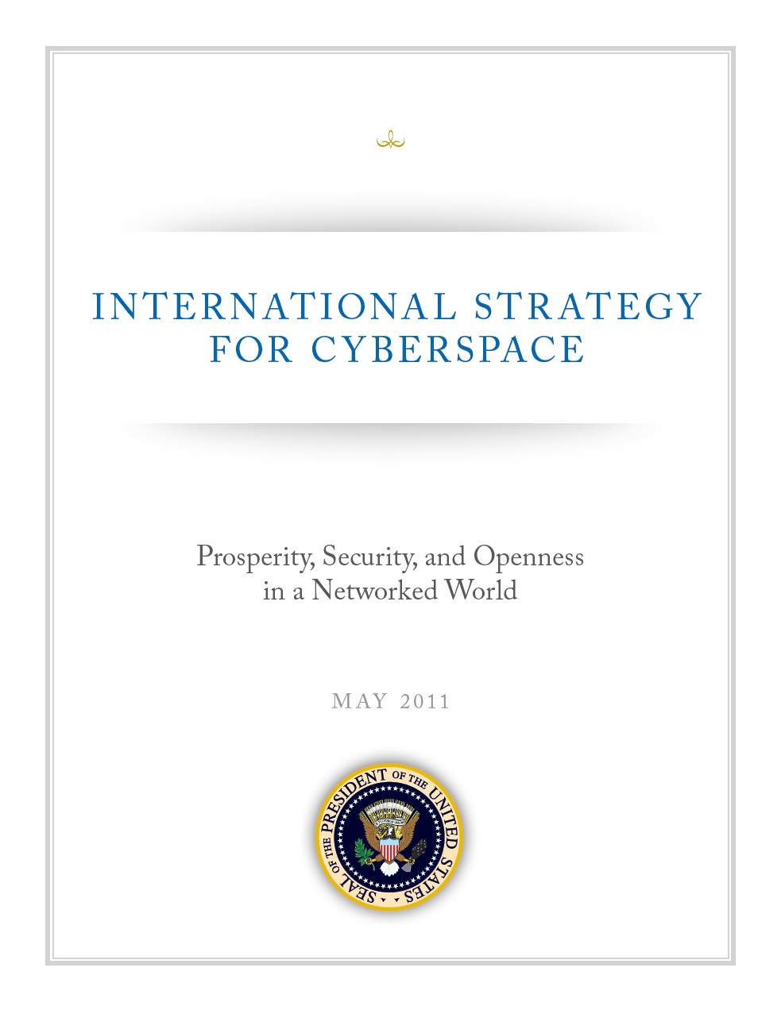
U.S. International Strategy for Cyberspace
Build and enhance existing military alliances to confront potential threats in cyberspace
Expand cyberspace cooperation with allies and partners to increase collective security
Provide knowledge, training, and other resources to countries seeking to build technical and cybersecurity capacity
Continually develop and regularly share international cybersecurity best practices

Slide 7
Sustain
Measure progress toward strategic goals
Build on Lessons Learned
Conduct periodic reassessment of environment and goals
Adjust focus for new priorities as needed

Slide 8
Summary
Building a MOD-specific cyber strategy provides a foundation to guide organizational investments and achievable objectives
Include leadership, operational and technical stakeholders in the Cyber Strategy development team
A good Cyber Strategy conveys intent, informs, and inspires
Cyber strategy development frameworks and methodologies are available if desired

Slide 9
Questions?
Please contact your local Embassy if you wish to engage with the USAFRICOM J69 Cybersecurity Engagement Team

