Slide 1
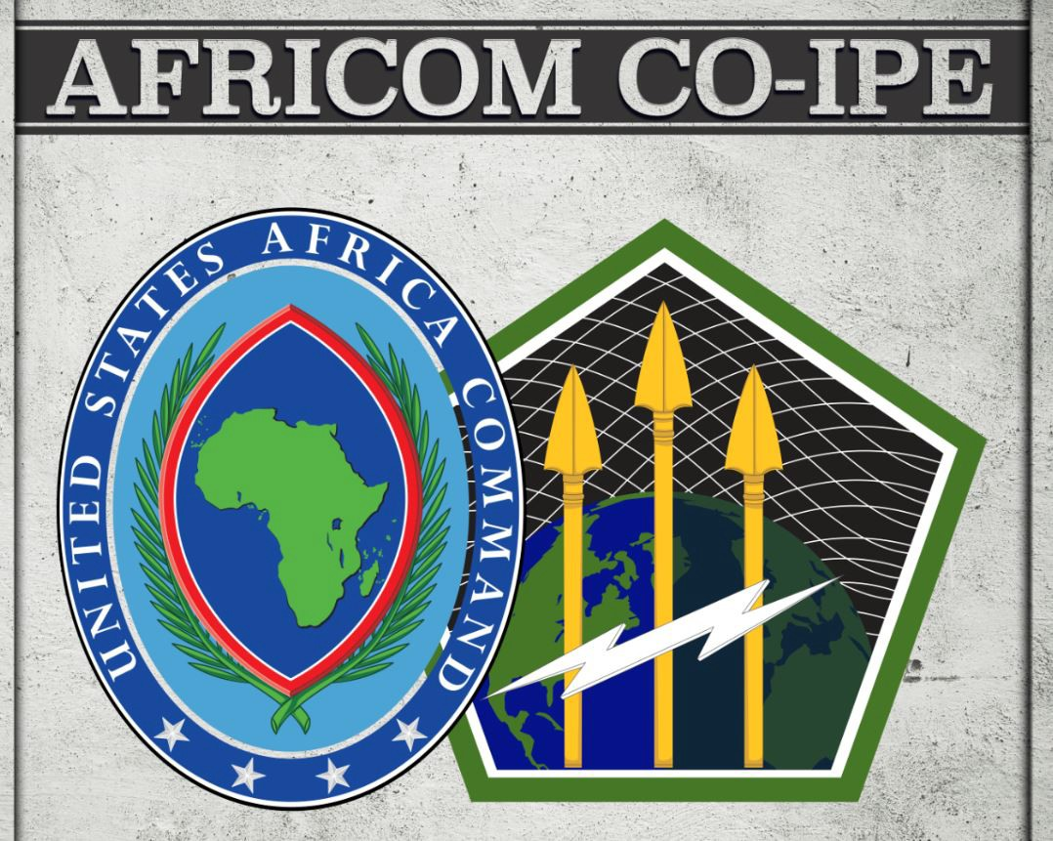
Whole-of-Government Approach to Cyber
Classification: UNCLASSIFIED
00030

Slide 2
Brief Overview
UNCLASSIFIED
The Cyber Domain
Cyberspace Adversarial Snapshot
Whole-of Government Approach to Cyber
DoD Cyber and Critical Infrastructure Equities
Key Take-Aways
UNCLASSIFIED

Slide 3
The Cyber Domain
UNCLASSIFIED
Cyber-
Individual
Manmade, global domain, integrated into all other domains
Used and controlled by diverse private and public entities
Domestic, Informational, Military & Economic considerations
3 distinct but interrelated layers contribute to complexity
Public, Commercial, and Adversarial network components
Persona
Cyber Identity
Logical
Information
Physical Network
Physical
Geographic Component
UNCLASSIFIED

Slide 4
The Cyber World is Interconnected
UNCLASSIFIED
Adversarial
States
US Government
Power Grid
Critical Infrastructure
Allies/ Partners
Financial Sector
Criminal Elements
Terrorists
Hacktivists
101000100011
101000100011
Online Services
101000100011
101000100011
Data
Voice
TV
Radio
Satellite
UNCLASSIFIED

Slide 5
UNCLASSIFIED
Whole-of-Government Approach
to Cyber
A whole-of government and whole-of alliance approach is key for cyber defense and critical infrastructure protection. Particularly in Africa, traditional boundaries and borders do not apply to most critical infrastructure.
A cyber attack resulting in degradation or denial of service could result in impacts to military operations, civilians, and ultimately governance structures
Partnerships are essential to protecting interconnected critical infrastructure.
A coordinated, whole-of-government and whole-of alliance approach strengthens the capacity and interoperability of organizations, allies, and partners to address evolving cyber threats.
UNCLASSIFIED
Notes:
Commercial cyber networks enable critical infrastructure that supports military operations that provide security and stability to Africa and the world, but also provide essential services to civilians
Approximately 90% of military logistical capabilities depend upon commercial sector cyber networks used to operate critical infrastructure

Slide 6
U.S. Whole-of Government Cyber Approach
UNCLASSIFIED
DOJ/FBI
Lead for
Investigation and Enforcement
DHS
Lead for Protection
DoD
Lead for National Defense
INTELLIGENCE COMMUNITY: Cyber Threat Intelligence & Attribution
SHARED SITUATIONAL AWARENESS ENABLING INTEGRATED OPERATIONAL ACTIONS
PROTECT | PREVENT | MITIGATE | RESPOND | RECOVER
Coordinate with Public, Private, and International Partners
Acronym Key
DHS Department of Homeland Security
DoD Department of Defense
DOJ Department of Justice
FBI Federal Bureau of Investigation
UNCLASSIFIED

Slide 7
2018 DoD Cyber Strategy
UNCLASSIFIED
Defense Objectives in Cyberspace
Ensuring the Joint Force can achieve its missions in a contested cyberspace environment.
Strengthening the Joint Force by conducting cyberspace operations that enhance
U.S. military advantages.
Defending critical infrastructure from malicious cyber activity that individually, or as part of a campaign, is likely to cause a significant cyber incident.
Securing DoD information and systems against malicious cyber activity, including on non-DoD-owned networks.
Expanding DoD cyber cooperation with interagency, industry, and international partners.
UNCLASSIFIED

Slide 8
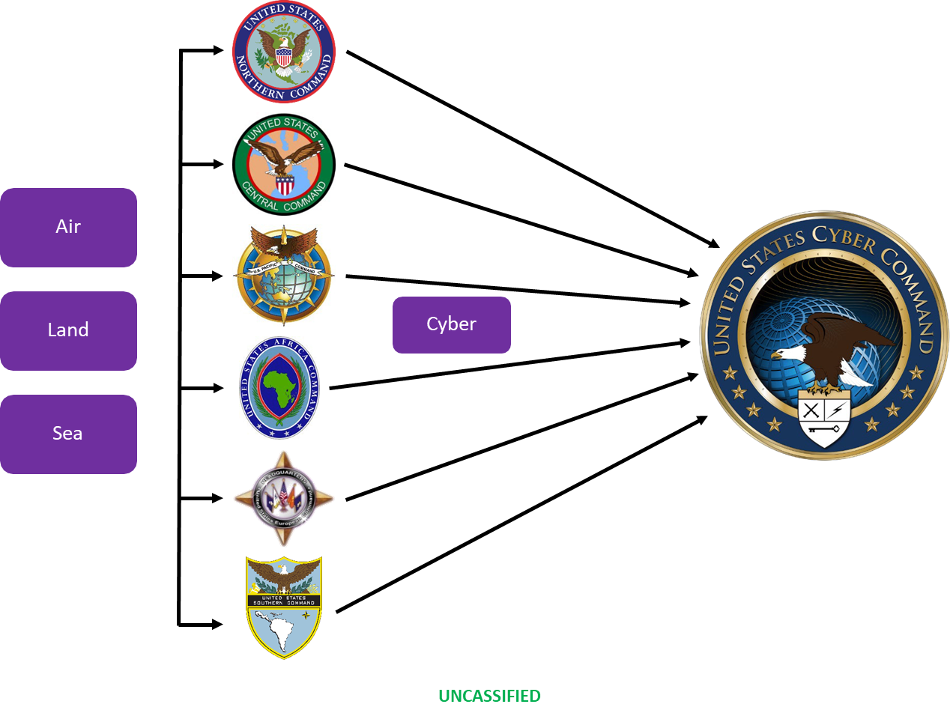
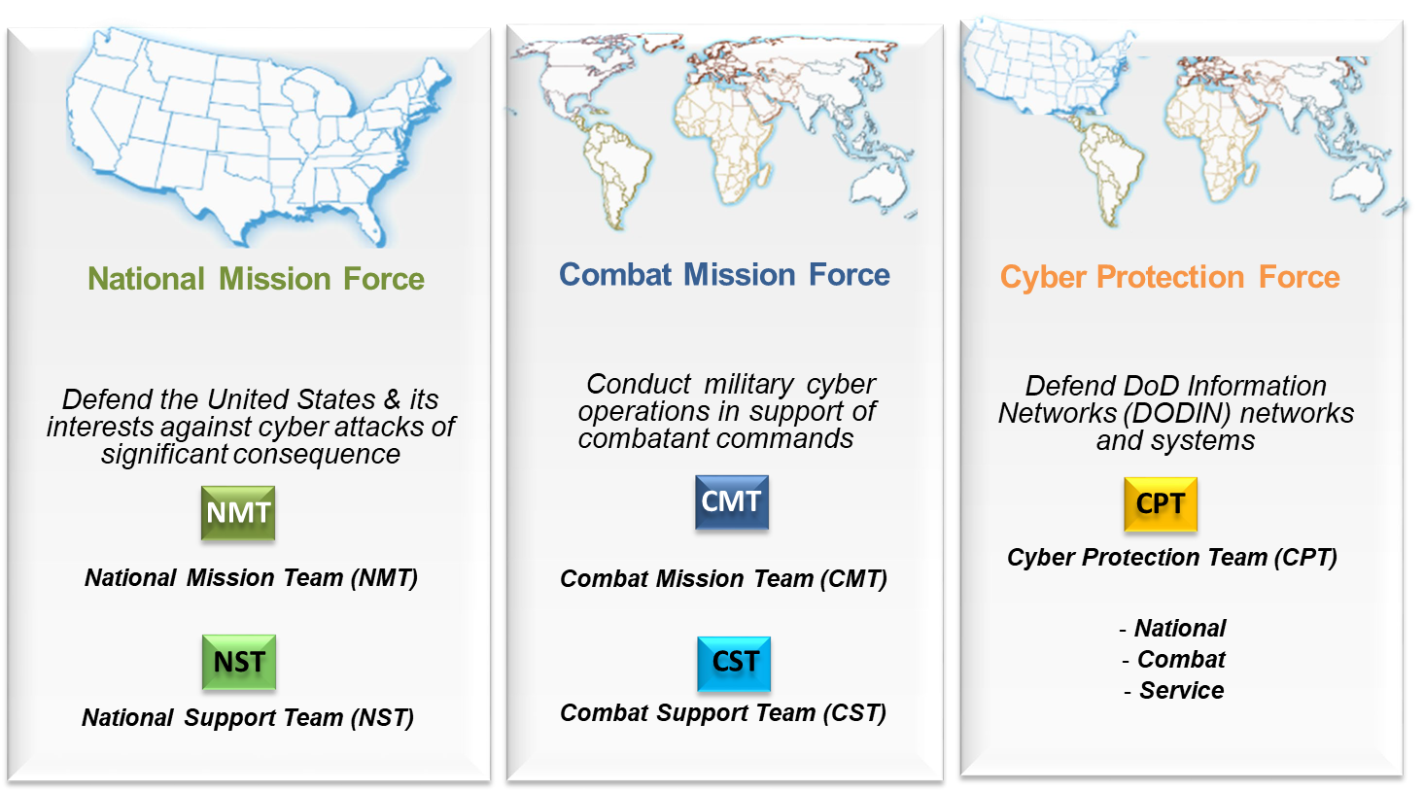
Combatant Command Cyber Integration
UNCLASSIFIED
Geographic combatant commands synchronize effects in the classical domains with one another
USCYBERCOM synchronizes effects in the cyber domain globally in support of the geographic combatant commands
8
UNCLASSIFIED

Slide 9
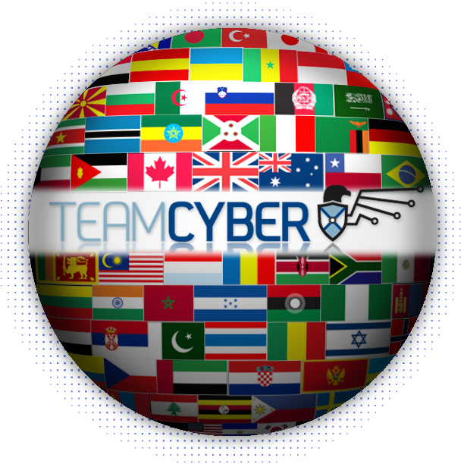
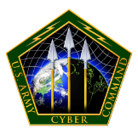
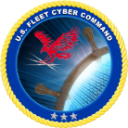
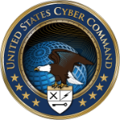
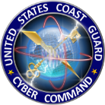
Key Take-Aways
UNCLASSIFIED
Partnerships and continuous information sharing is critical.
Infrastructure and network vulnerabilities are not solely a national problem, we are all interconnected and must work together.
Investment in cyber defense is more cost effective than repairing damage caused by cyber-attacks.
Policies that stretch across military, government, and commercial sectors need to be pro-actively established to mitigate critical infrastructure vulnerabilities.
Coalition & Partners in Cyber
UNCLASSIFIED
Notes:
NEW

Slide 10
Questions ?
UNCLASSIFIED
UNCLASSIFIED

Slide 11
Threats in Cyberspace
UNCLASSIFIED
State Actors
Unlike physical domains, the norms of responsible state behavior in cyberspace remain unsettled.
Non-State Actors GLOBAL, UNACCOUNTABLE
Tend to focuses on diplomatic, military, and economic targets to maintain operational and technological advantage
Cyber programs integrated into national and military strategy
Hacktivists promote a social or legal issue, political ideology
Cyber Criminals, motivated by profit
Proxy Actors support state-sponsored causes
Terrorists promote extremist ideology
Appropriate norms of response are also undetermined.
Asymmetric Warfare
Willing to employ destructive cyber-attacks as an asymmetric response to perceived threats or provocations
Threats to Intellectual Property / Competitiveness
Cyber activity and espionage continue despite private sector reports, official accusations, indictments of cyber actors Actors can be both commercial and state
Low Cost of Entry
Cyber can be an equalizer between adversaries – cyber attack tools are inexpensive, while robust cyber security requires more resources and commitment
Rapid technological changes present challenges and opportunities
Expanding power of autonomy, Artificial Intelligence, persistent sensing, commercial IT
Theft of sensitive DoD information has eroded our military edge
Legacy IT and Industrial Control Systems (ICS), now networked, provide easy targets for adversaries to compromise critical infrastructure
Cyber Attacks are difficult to attribute; retribution as a deterrence is often ineffective
UNCLASSIFIED

