Slide 1
Neuroscience Insights on Radicalization and Mobilization to Violence: A Review. (2nd Edition)
Summary of key points, provided by
Diane DiEuliis, PhD.
(US Department of Health and Human Services)
National Defense University
Department of Defense

Slide 2
Why Neuroscience?
Psychology gives way to Cognitive neuroscience:
the neural substrates underlying cognition; how the brain creates the mind
Advances in neurogenomics and neuroimaging:
Providing new insight into the vagaries of human behavior
Advances in multidisciplinary research: computation, big data, engineering, chemistry, synthetic biology, etc, come together to innovate
“Integrated Advanced Scientific Convergence” IASC
“Nano-Bio-Cogno-Info”

Slide 3
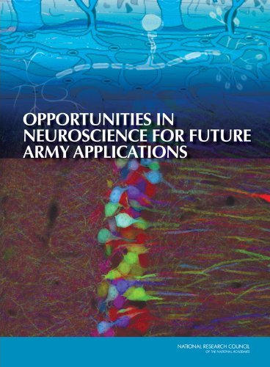
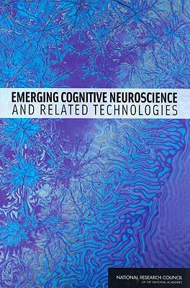
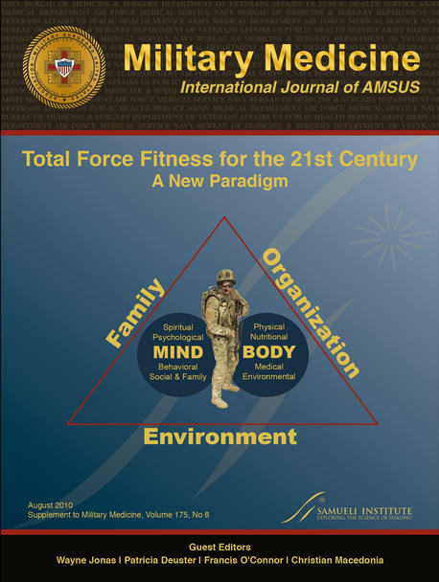
Challenge space
Behavioral neuroscience is a relatively new field not well studied;
Neuroscience research is conducted in laboratories – not all findings are easily generalized to operational settings.
Neuroscience has not been traditionally applied to national security.
Neuroscience literature may not be easily accessible.
Notes:
High potential for technological surprise;
High potential for Dual Use implications
Many NAS/other recommendations for DOD in this space
“Neurodeterrence”

Slide 4
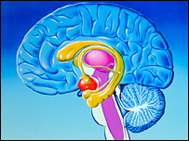
Some basic anatomy
Cortex = highest level thinking
“toolbox” = memory, learned experiences, etc
Amygdala = fear, freeze, flight, “amygdala hijack” or “basement”
Notes:
The “fight, flight, or freeze” response that individuals have to a situation is regulated! by the amygdala: for instance, people’s tendency to approach or avoid a given situation may be affected by the extent to which the amygdala responds to a given event in the environment. Culture affects how people show enhanced amygdala response to affective scenes across cultures.

Slide 5
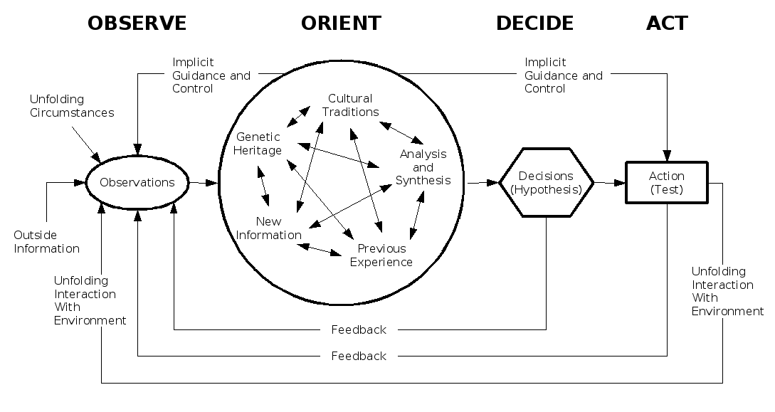
OODA loop neurobiology
Amygdala
Cortex
toolbox

Slide 6
Neurobiology is an added layer
Understanding the neurobiology of human behavior can provide added dimension to formulating strategies to prevent aggression and influence radicalization.
As the security environment becomes increasingly complex, rapid decisions must be made about operational approaches;
Chances for success could be increased by creating approaches that incorporate basic neurobiological tools.

Slide 7
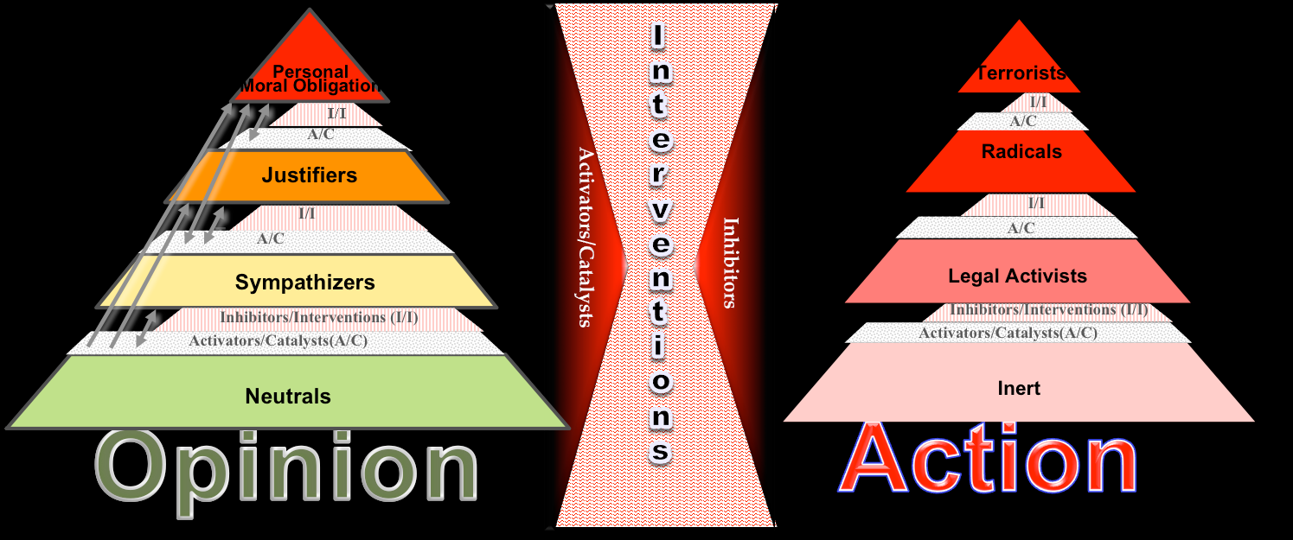
“Two Pyramids” Radicalization Framework
Clark McCauley, Neuroscience Insights on Radicalization and Mobilization to Violence: A Review. (2nd Edition)
Strategic Multilayer Assessment (SMA) Dec. 2012.
Notes:
Points on the pyramid
Radicalization can be “opinions” – this is not against the law, the Constitution fundamentally allows that.
Its when they take action that becomes the problem.
What takes people from the left pyramid to the right pyramid is the big challenge space and where much research is focused.
This is not one-way, people can move up or down on each of these pyramids.
(this is not a ‘conveyor belt’)

Slide 8
Internal factors
Genetics and neurodevelopment (note: the brain is not fully developed until late teens/early 20s).
Identity – formed during development; family and in-groups
Sacred values – particular beliefs that are inviolate – not malleable or easily changed.
Emotion plays a role as seen from amygdala circuitry and is internally regulated in response to external stimuli.
Notes:
No one individual is genetically or biologically predisposed to political violence (Hatemi, et al 2011). Rather, individuals who may be more disposed to
engage in violence when threatened in general will become motivated to act because of particular provocations. Genetics are implicated in predispositions – not causality.
Two genes involved in the future of cultural neuroscience work include serotonin (5ZHTTLPR) and dopamine (DRD4) (Chiao, et al 2009), Chiao & Blizinksy 2010. Possessing the serotonin gene 5MHTTLPR is associated with increased negative emotion including anxiety, harm avoidance, fear conditioning, attentional bias to negative information, increased risk for depression in the presence of environmental risks, particularly in Western populations. In particular, exposure to chronic life stress, such as interpersonal conflict, loss. These genes vary in South American Indians and east Asians.
Trying to change a person’s or group’s values leads to hostility. Research also indicated that when individuals process statements regarding sacred values, they use neural systems associated with evaluating rights and wrongs and sematic rule retrieval but not systems associated with determining costs and benefits. Individuals are unable to make tradeoffs concerning sacred values due to the neural system utilized (Berns, et al., 2012).

Slide 9
External Factors
Culture
Life experiences
Narratives
Social networks (note: social networks no longer rely on geography – social media is a medium through which networks are formed)
Environment (note: environment is more easily manipulated than someone’s fundamental internal neuropsychology)
Notes:
Life experiences – these include everything from history of violence, competition over scarce resources, trauma, military service, level of education, etc.
Narratives can alter a person’s beliefs attitudes and intentions. They frame the world in which an individual lives – additionally they provide an alternate form of rationality and simplify complex mental tasks (may lead a person to yield to persuasive calls to action) Extremist groups are very good at using narratives to persuade potential recruits that they have a moral imperative to join the cause. Once established narratives are self perpetuating and more difficult to counter.

Slide 10
Indicators: understanding motivation
Emotional vulnerability, feelings of isolation increase susceptibility to radicalization.
Social instability (affect social identities, follow particular leaders, uniting against common enemy, etc.)
People join groups to develop identity, to enhance ‘belonging’, receive reward/validity, follow norms.
Notes:
Individuals are radicalized:
1) A sense of alienation and marginalization for those transplanted out of their original cultures;
2. A loss of positive self concept/identify, (both of which are met by group dynamics, loyalty, and a sense of belonging to the group);
3. A desire for adventure; And life meaningfulness;
4. A resonance to secondary traumatization occurring in the first group (i.e., identifying with traumas and injustices done for instance to Muslims in Chechnya and Palestinian territories) and indirect traumatization from viewing images of these populations on television and internet; !and
5. Lastly a desire for personal redemption from corruption.” (Speckhard 2005, p17)
“shared grievances and generalized! beliefs (loose ideologies) about the causes and possible means of reducing grievance are important preconditions for the emergence of social movements” or collective action, including Terrorist and radical groups (McCarthy&Zald, 1977; Klandermans, Roefs, & Olivier, 2001; Olson, 1971).

Slide 11
Recommendations based on neurobiological understanding
Providing new, alternative (in)groups;
Material incentives will not work to change sacred values; similarly enforcing USG “norms” should not be attempted; Promote change through developmental assistance programs rather than try to change values.
Provide culturally appropriate models for heroic action that appeal to the idealism of youth, dreams of glory, search for dignity and respect, belonging etc.
Explore ways to honor rather than eradicate tribal customs
Providing competing narratives, competing myths, destabilizing radical myths and narratives
Use local networks
Promote environments which support changes naturally
Focus on peer to peer efforts
Notes:
Narratives are dependent upon successful creation of myths. Myths that weave together facts about past and present situations to create emotially compelling backgrounds influences the susceptibility of a population to manipulation by myth mongers (Casebeer, 2005)
One popular narrative is the “common enemy” and this becomes the frame through which locals interpret their grievances be they local national or ideological. (Everington, 2011)

Slide 12
Recommendations cont.
Current intervention strategies, including counter-radicalization commercials and SMS messages, “are ineffective by themselves at triggering a change in attitude or behavior. Media should be used to shape the general environment in which the seeds of counter-radicalization can be sown” (Everington, 2011).
Understanding how ideas are spread and what makes them compelling is “essential for developing strategies for the prevention, detection of the emergence, and tracking of violent extremism” (Gupta, 2011).

Slide 13
Thanks
This document is one attempt at introducing novel concepts of the interaction of the brain and the environment to operational users. As the field advances and more research is conducted in the national security sphere, neuroscience may become a critical component of planning and analysis within the U.S. Department of Defense. In the meantime, the SMA effort will continue to foster a community of interest that bridges the operational and Neuroscience community.
Questions?

Slide 14
Reference Material
Neuroscience Insights on Radicalization and Mobilization to Violence: A Review. (2nd Edition)
Cyber on the Brain: The Effects of CyberNeurobiology & CyberPsychology on Political Extremism (October 2012)
Influencing Violent Extremist Organizations Pilot Effort: Focus on Al Qaeda in the Arabian Peninsula (Fall 2011)
SMA 5th Annual Conference Proceedings Nov. 2011 Panel on Implications of Recent Advances in Social, Cognitive & Neurobiological Science to National Security

